Slide 1
Back to modeling
Methods 3: multilevel modeling and machine learning
Questions?

Slide 2
The plan for the next two weeks
Back to statistical basics (today):
General intro to Bayesian inference
Building the simplest model: Describing the data as a Gaussian
Difference of means as a Gaussian distribution (linear regression w dichotomous predictor, t-test)
Back to programming basics (tomorrow)
Making messy data tidy (Assignment 0: preprocessing data for Assignment 1)
Then comes trouble (lecture next week)
Repeated measures (population vs. individuals) (multilevel/hierarchical modelling, or random/varying effects, paired sample t-test)
Informed (previous literature) priors
? Model comparison ?
Getting your feet wet (class next week)
Class just running step by step (and improving?) the analysis from these 2 weeks and making sure you explicit your doubts and questions
So you are ready for the more involved project in Assignment 1 (and lectures)

Slide 3
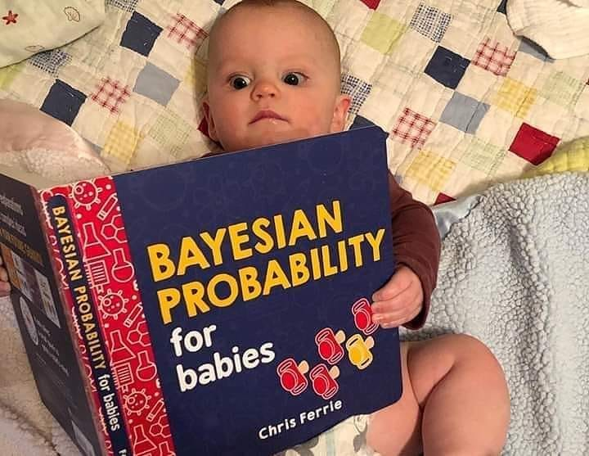


Bayesian catch up

Slide 4
Basic terminology
The probability of a theory (parameter values) given the data is
Prior: What we already knew
Likelihood: What the data tells us
Posterior: What we know now
X
=
3Blue1Brown on Bayes Theorem
https://www.youtube.com/watch?v=HZGCoVF3YvM

Slide 5
Why Bayes (Student answers)
[Knowing what the fuzz is about]
Avoiding convergence issues in complex models
More flexibility in building models
Testing any hypothesis (not just the null)

Slide 6
Why Bayes (my take)
Principled way of building your model:
Thinking through what you know
Thinking through (with plots!) the implications of what you think you know

Slide 7
Why Bayes (my take)
Principled way of building your model:
Thinking through what you know
Thinking through (with plots!) the implications of what you think you know
Easy to break: It fails often, it fails catastrophically, with nice diagnostics

Slide 8
Why Bayes (my take)
Principled way of building your model:
Thinking through what you know
Thinking through (with plots!) the implications of what you think you know
Easy to break: It fails often, it fails catastrophically, with nice diagnostics
It scales up:
Same tools and workflow for t-tests, general regression models, but also actual mathematical models of cognitive processing e.g. reinforcement learning or mathematical models of theory of mind

Slide 9
But, why Bayes, Why? (worries)
Subjective
Lots of choices, lots of self-doubt
Making choices (e.g. priors) is (should be?) a principled process
assessing choices (e.g. priors) is part of the process:
prior predictive checks
prior posterior update checks
robustness checks

Slide 10
But, why Bayes, Why? (worries)
Subjective
Lots of choices, lots of self-doubt
Making choices (e.g. priors) is (should be?) a principled process
assessing choices (e.g. priors) is part of the process:
prior predictive checks
prior posterior update checks
robustness checks
Complex
Less off-the-shelf than freq
not more complex than frequentist statistics, just more aware of what you are doing
It scales up

Slide 11
But, why Bayes, Why? (worries)
Subjective
Lots of choices, lots of self-doubt
Making choices (e.g. priors) is (should be?) a principled process
assessing choices (e.g. priors) is part of the process:
prior predictive checks
prior posterior update checks
robustness checks
Complex
Less off-the-shelf than freq
not more complex than frequentist statistics, just more aware of what you are doing
It scales up
See previous slide
https://doi.org/10.1093/brain/awab065
It takes time
Yes, frustratingly much time!
On the other hand: is your work worth the time to make sure you are doing it right?

Slide 12
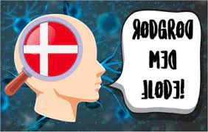
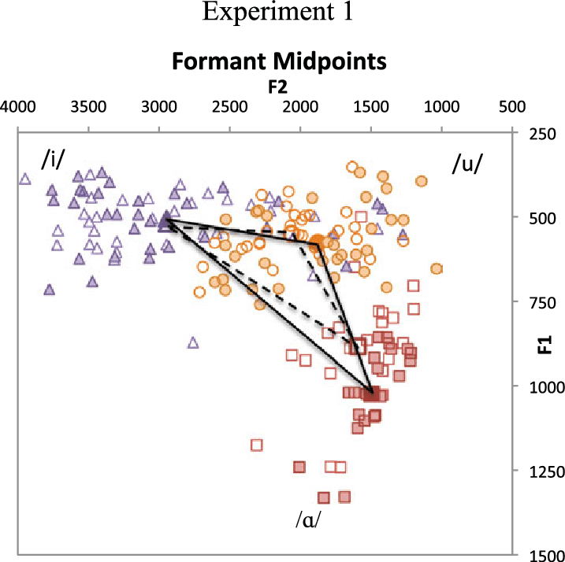
Learning by example

Slide 13
Vowel hyperarticulation in IDS
When speaking to children (pets and second language learners) people tend to overemphasize the distance between vowel sounds
? To make them easier to discriminate and/or learn?
Cox et al (in press) A Systematic Review and Bayesian Meta-Analysis of the Acoustic Features of Infant-Directed Speech -> all but maybe Dutch or Cantonese

Slide 14

But Danish!
Danish has an obnoxious number of vocalic and semi-vocalic sounds
Why make it easy on the children to learn them?
Danish IDS is not hyper-articulated
Bohn, O-S. (2013). Acoustic characteristics of Danish infant directed speech. Meetings on Acoustics. Proceedings.
Danish IDS is hypo-articulated
Dideriksen, C. R.,(2018). IDS is not what you think - Hypoarticulation in Danish Child Directed Speech. MA thesis

Slide 15


The analysis plan
New dataset
24 mothers speaking 30 min to their child (home, free interaction) and to a research assistant (2 datapoints per mother)
We model articulation as the simplest model: a Gaussian distribution
Silly? We need to learn to play with priors and likelihood.
We model articulation by register (IDS vs ADS)
We add a dichotomous predictor
We include "repeated measures"
And worry about the articulation between population and individual levels
We include informed (previous literature and meta-analysis) priors

Slide 16
Coding note
All the code conventions used are based on brms
An attempt at bridging frequentist and Bayesian practices by taking up lme4’s syntax and extending it
While rstanarm comes with premade precompiled models, brms allows you to define a broader range of models (but then needs to compile them).
Brms is a gateway to STAN (more flexible, but yet a different language, we’ll cover it in Advanced Cognitive Modeling)
Here code snippets, the full code is on the gitbook I linked in the syllabus
Please try the full workflow on your computer and play with it and figure out your doubts. Not this, but the next class is taken by running the code and discussing the doubts.

Slide 17
Let’s go!

Slide 18
Articulation Measure
Standardized vowel area
Subtract the mean
Divide by the standard deviation
Simpler to deal with
Limited range
Comparability with other studies
Standardized effect sizes (cohen’s d)
Lots of knowledge/intuition

Slide 19
Modeling articulation (Simplest)
Articulation_f1 <- bf(Articulation ~ 1)
Articulation ~ Normal(mu, sigma)
Mu = ?
Sigma = ?
get_prior(Articulation_f1, data = d, family = gaussian)
Intercept (or mean expected value of articulation, here = mu)
Sigma (or average expected error when predicting datapoints from mu)

Slide 20
Setting priors: MU
Priors
What do we know?
The data has been scaled: centered at 0, divided by sd (so its sd is one)
prior(normal(0, 1), class=Intercept)
Questions?

Slide 21
Setting priors: Sigma
Priors
What do we know?
Scaled: 1 SD = 1
We expect our model to do approximately like the mean in predicting our data (since that is our model!)
Prior(normal(1, ?), class=sigma)
What about sd of the sigma?
Let’s be optimistic and say that we could in principle (but unlikely!) go all the way down to 0:
1 to 0 is 1, which corresponds to 2 sd, so 0.5
Prior(normal(1, 0.5), class=sigma)

Slide 22
Really?
Well, let’s check
First the mean expected value
rnorm(1e4, mean=0, sd = 1)
Articulation_p1 <- c(prior(normal(0,1), class= Intercept), prior(normal(1, 0.5), class= sigma))

Slide 23
Really?
Well, let’s check
First the mean expected value
rnorm(1e4, mean=0, sd = 1)
Articulation_p1 <- c(prior(normal(0,1), class= Intercept), prior(normal(1, 0.5), class= sigma))

Slide 24
Really?
Well, let’s check
First the mean expected value
rnorm(1e4, mean=0, sd = 1)
Then we add the sigma
rnorm(1e4, mean=rnorm(1e4, 0, 1), sd = rnorm(1e4, 1, 0.5))
Articulation_p1 <- c(prior(normal(0,1), class= Intercept), prior(normal(1, 0.5), class= sigma))

Slide 25
Really?
Red = prior mu
Blue = prior outcome (mu + sigma)
Well, let’s check
First the mean expected value
rnorm(1e4, mean=0, sd = 1)
Then we add the sigma
rnorm(1e4, mean=rnorm(1e4, 0, 1), sd = rnorm(1e4, 1, 0.5))
Articulation_p1 <- c(prior(normal(0,1), class= Intercept), prior(normal(1, 0.5), class= sigma))

Slide 26
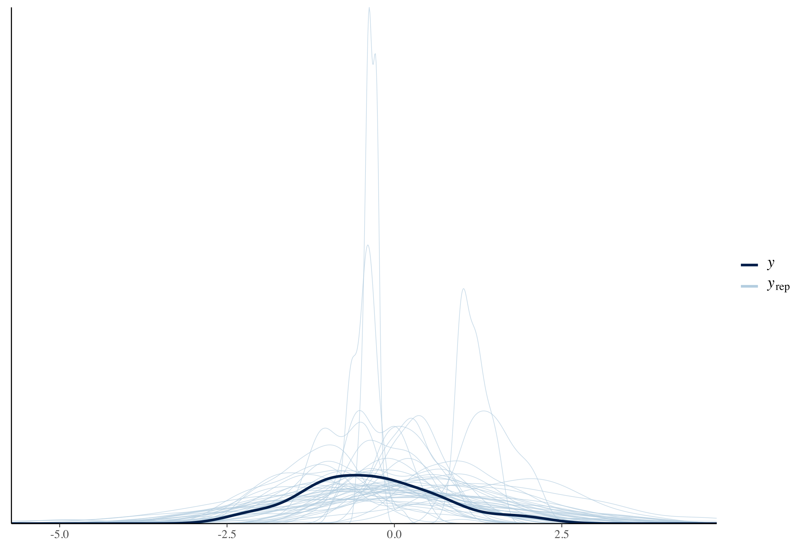
Prior Predictive checks For the Lazy
Articulation_m1_prior <- brm( Articulation_f1, # Articulation ~1 data = d, family = gaussian, prior = Articulation_p1, sample_prior = “only”, …)
pp_check(Articulation_m1_prior, ndraws =100)
100 simulations from the priors (in blue)
Sample a random value from both priors, generate as many datapoints as in the data
Overlay the actual data as reference (in black)

Slide 27
Now we are ready to fit the model
Articulation_m1 <- brm( Articulation_f1, # Articulation ~1 data = d, family = gaussian, prior = Articulation_p1, sample_prior = T, …)
What does it mean to fit a model?

Slide 28
The sampling process
https://chi-feng.github.io/mcmc-demo/app.html (HMC, standard target)
Chains: independent sampling processes
Iteration
Start at random from prior (first time)
Move at random for N leap-frog steps with M step size (automatically learned during warming, using adapt_delta and max_tree_depth). After the first step, use momentum and gradient to shape the trajectory.
Is the final point respecting the physics of Hamilton (momentum and potential energy trade-off)?
If so use it as sample, otherwise it’s a divergence, go back to start.
Set the current sample as starting point for a new iteration
All iterations ending points are posterior samples (including divergences)

Slide 29
Posterior predictive checks
100 simulations from the posteriors (in blue)
Sample a random value from both posteriors, generate as many datapoints as in the data
Overlay the actual data as reference (in black)
pp_check(Articulation_m1, ndraws=100)

Slide 30
Posterior predictive checks
100 simulations from the posteriors (in blue)
Sample a random value from both posteriors, generate as many datapoints as in the data
Overlay the actual data as reference (in black)
pp_check(Articulation_m1, ndraws=100)

Slide 31
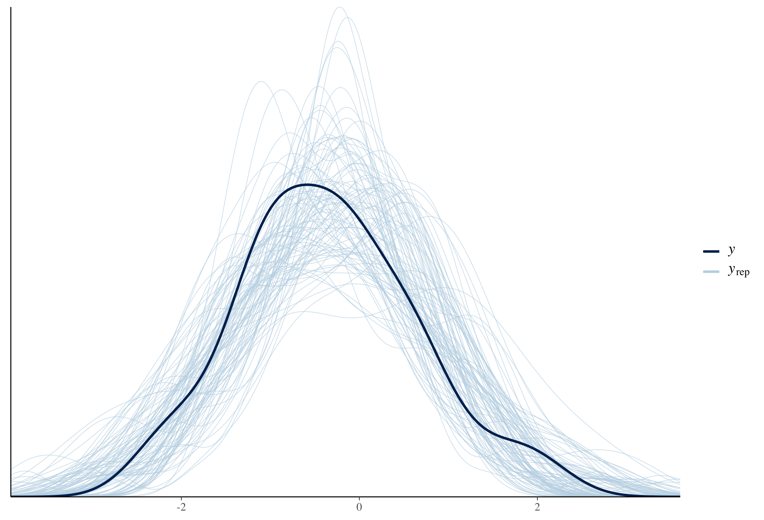
Posterior predictive checks
100 simulations from the posteriors (in blue)
Sample a random value from both posteriors, generate as many datapoints as in the data
Overlay the actual data as reference (in black)
pp_check(Articulation_m0_prior, ndraws=100)

Slide 32
Prior-Posterior Update checks
MU / Intercept
Sigma
Articulation_p1 <- c(prior(normal(0,1), class= Intercept), prior(normal(1, 0.5), class= sigma))

Slide 33
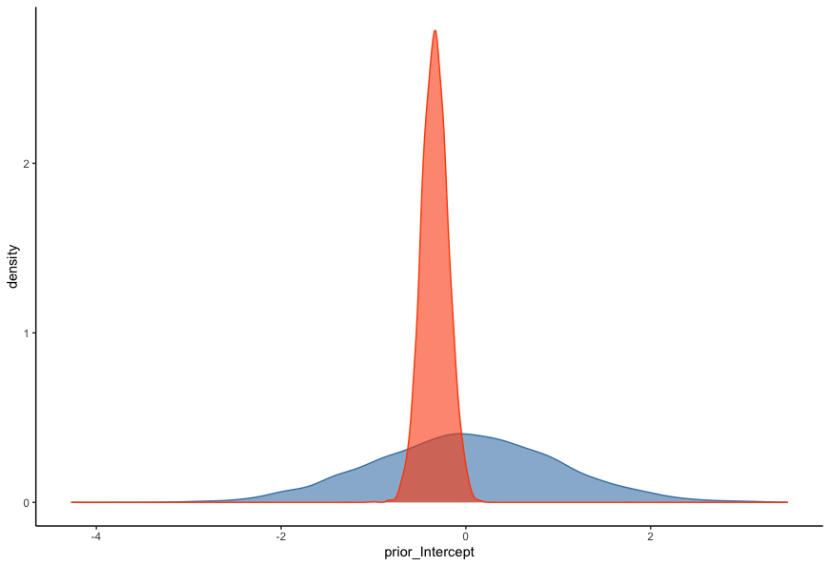
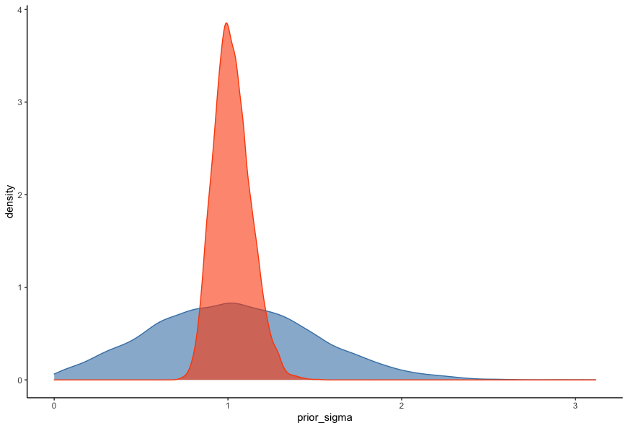
Prior-Posterior Update checks
Blue = prior
Orange = posterior
MU / Intercept
Sigma
Articulation_p1 <- c(prior(normal(0,1), class= Intercept), prior(normal(1, 0.5), class= sigma))

Slide 34
Bad examples: Predictive Checks
Blue = predictions
Black = data

Slide 35
Bad examples: Predictive Checks

Slide 36
Bad (?) Examples: Prior posterior updates
Blue = prior
Red = posterior

Slide 37
Bad (?) Examples: Prior posterior updates
Blue = prior
Red = posterior

Slide 38
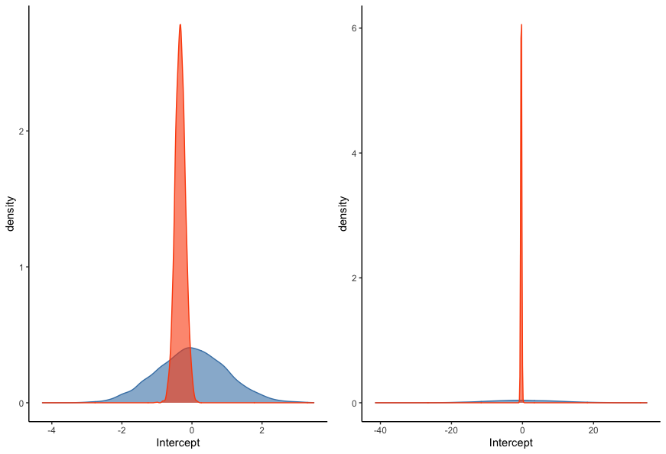
What about these?

Slide 39
Discussion
Q: How do we set priors (in this very simplified situation?)
We always know something (thinking of the scale is key)
Setting priors is less subjective than you think
Systematic workflow to assess the implications of your priors and adjust them (and more later)
Relate to known scales for the parameters
Relate to predicted outcome scales and what you know about them
Scaling can be your friend
Make sure that the model is learning
You can always test for how robust your inference is by changing priors and re-running (see later slides)

Slide 40
Take home for now
Model things one step at a time
Use the information you have (and you always have information!)
Obsessively check what you are telling the model
Don’t be afraid to change and adjust your models

Slide 41
Assessing contrasts

Slide 42
Assessing contrasts
We are interested in the contrast between registers (ADS and IDS)
Articulation_f2 <- bf(Articulation ~ 1 + Register)
Articulation ~ Normal(mu, sigma)
Mu = Intercept + b * Register
Intercept = ?
B = ?
Sigma = ?
get_prior(Articulation_f2, data, family = gaussian)
Intercept (mean expected value of articulation when register is 0)
B (mean expected difference between register = 1 and register = 0, IDS & ADS)
Sigma (or average expected error when predicting datapoints from MU)
N:B. same as a t-test!

Slide 46
Priors

Slide 47
Priors

Slide 48
Setting the priors
Intercept
Prior(normal(0, 1), class=Intercept)

Slide 49
Setting the priors
Intercept
Prior(normal(0, 1), class=Intercept)
Sigma
Prior(normal(1, 0.5), class=sigma)

Slide 50
Setting the priors
Intercept
Prior(normal(0, 1), class=Intercept)
Beta
What do we know?
Range of plausible effect sizes?
Sigma
Prior(normal(1, 0.5), class=sigma)

Slide 51
Setting the priors
Intercept
Prior(normal(0, 1), class=Intercept)
Beta
What do we know?
Range of plausible effect sizes?
-0.6 to 0.6
Prior(normal(0, 0.3), class = b)
Sigma
Prior(normal(1, 0.5), class=sigma)

Slide 52
Setting the priors
Intercept
Prior(normal(0, 1), class=Intercept)
Beta
What do we know?
Range of plausible effect sizes?
-0.6 to 0.6
Prior(normal(0, 0.3), class = b)
Sigma
Prior(normal(1, 0.5), class=sigma)
Articulation_p2 <- c( Prior(normal(0, 1), class=Intercept), Prior(normal(0, 0.3), class = b), Prior(normal(1, 0.5), class=sigma) )

Slide 53
Priors

Slide 54
Checking the priors
Articulation_m2_prior <- brm( Articulation_f2, data = data, family = gaussian, prior = Articulation_p2, sample_prior = “only”)
pp_check(Articulation_m2_prior, ndraws=100)

Slide 55
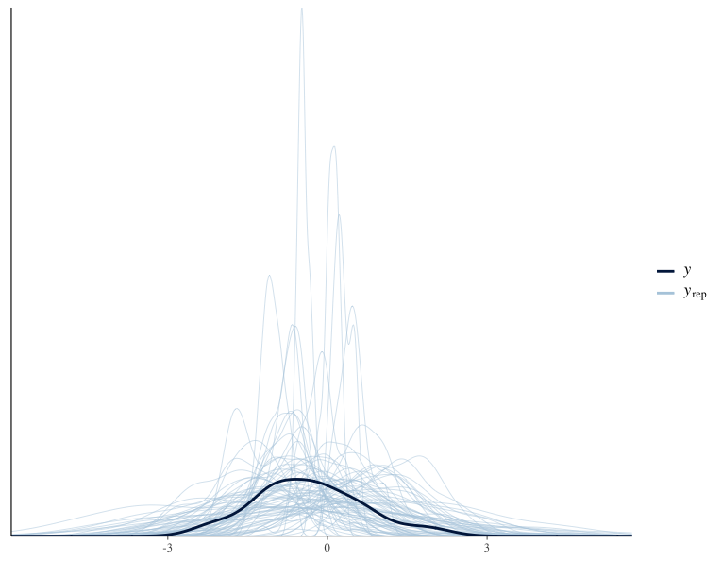
w/o register
w register

Slide 56
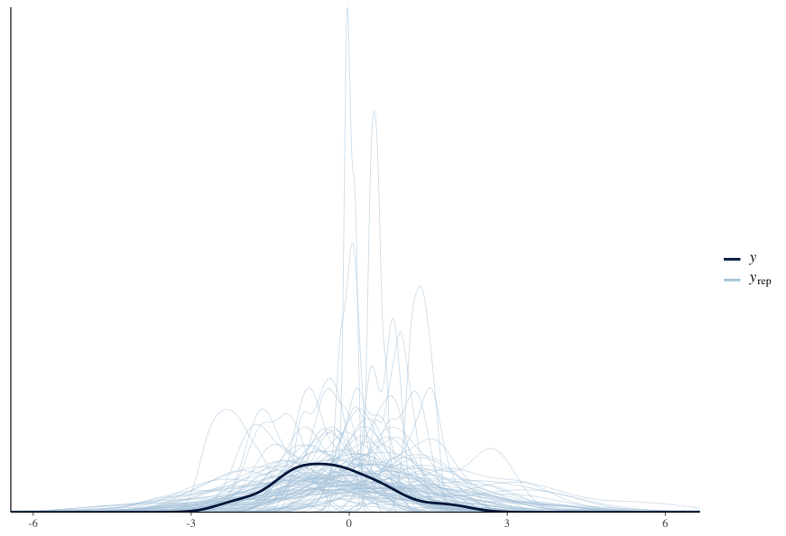
w/o register
w register

Slide 57
Fitting the model
Articulation_m2 <- brm( Articulation_f2, data = data, family = gaussian, prior = Articulation_p2, sample_prior = T)

Slide 58
Posterior Predictive checks
pp_check(Articulation_m2, nsamples=100)

Slide 59
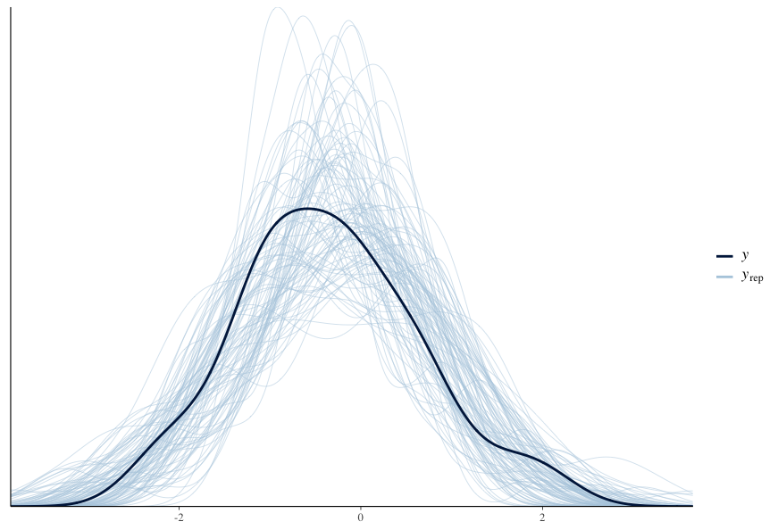
Posterior Predictive checks
pp_check(Articulation_m2, nsamples=100)

Slide 60
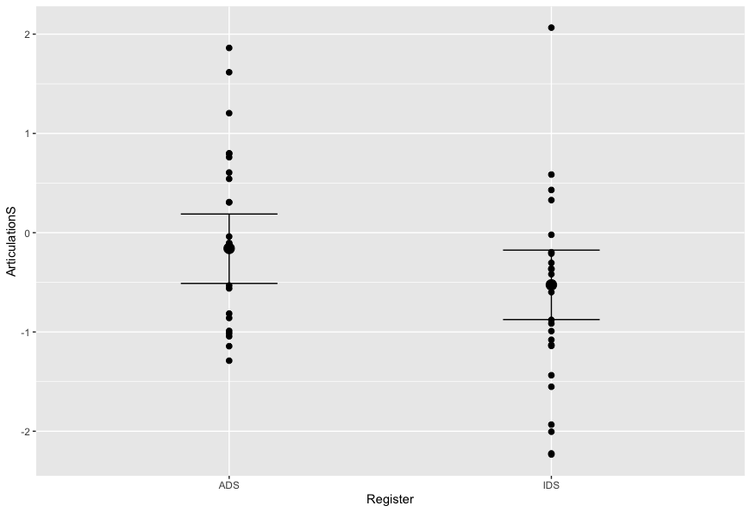
Posterior Predictive checks
plot(Conditional_effects(Articulation_m2), points=T)

Slide 61
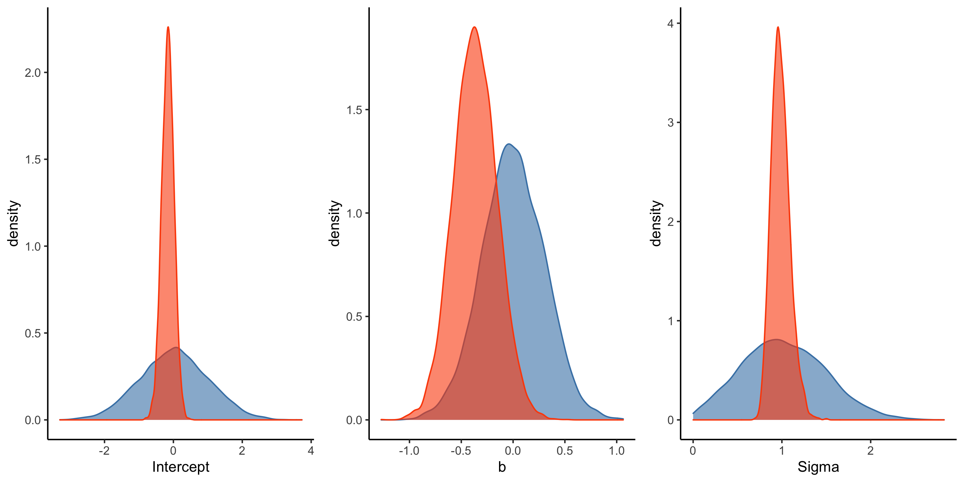
Prior Posterior update checks
Prior(normal(0, 1), class=Intercept), Prior(normal(0, 0.3), class = b), Prior(normal(1, 0.5), class=sigma)

Slide 62
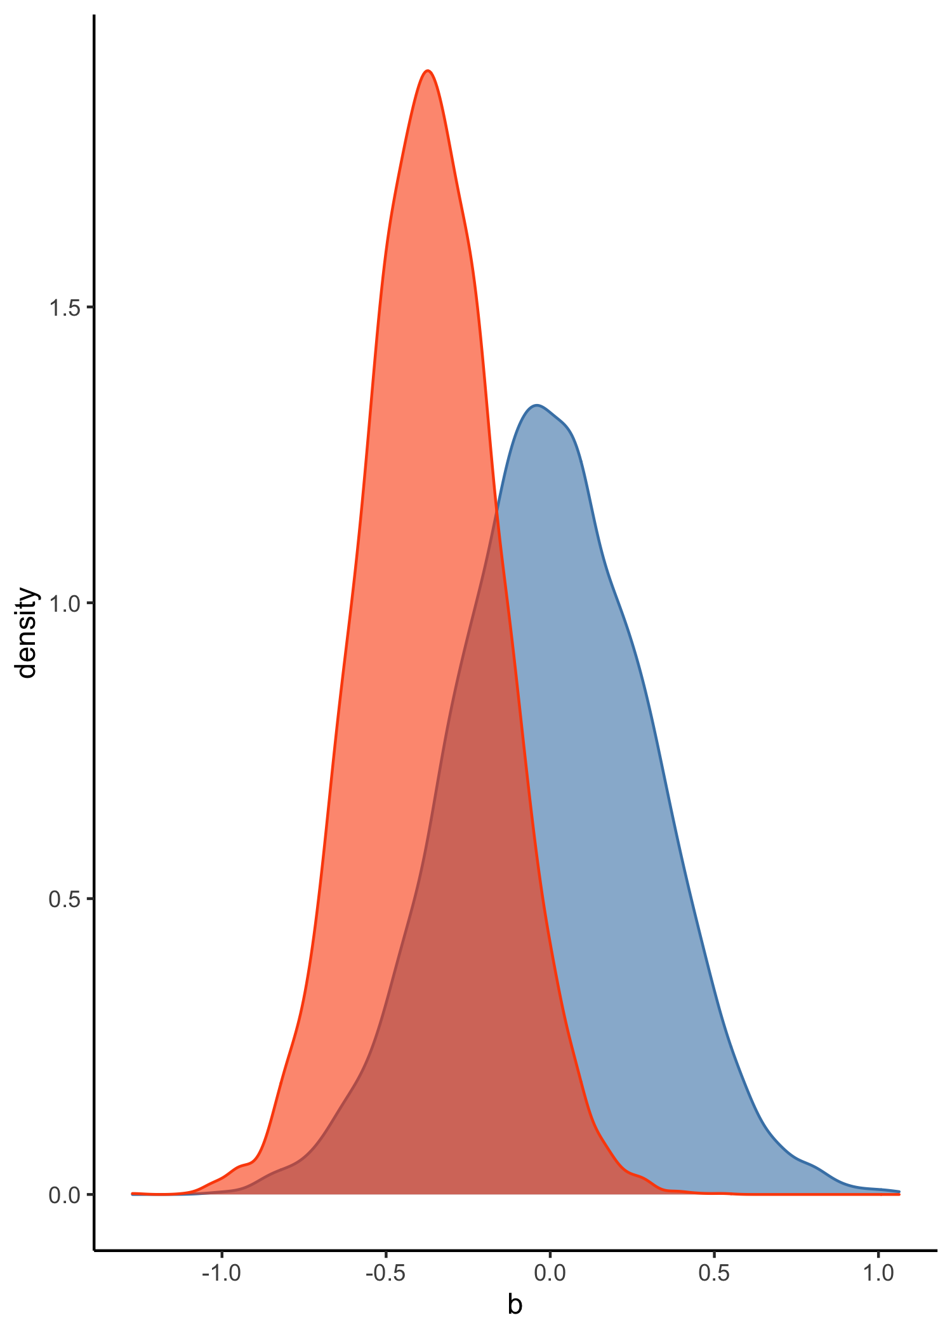
Assessing the contrast
The difference is estimated as -0.36 with a standard error of 0.21
But sometimes we want to more explicitly test an hypothesis (assess how many of the posterior samples are compatible with a given hypothesis)
Previous literature (MA) says that IDS is hyperarticulated
hypothesis(Articulation_m2, “Register > 0”)
1 previous Danish study says that Danish IDS is the same as ADS
hypothesis(Articulation_m2, “Register = 0”)
1 previous Danish study says that Danish IDS is hypoarticulated
hypothesis(Articulation_m2, “Register < 0”)

Slide 63
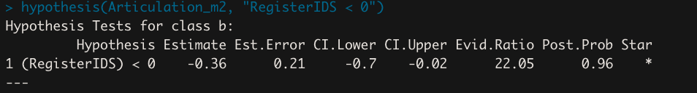
Hypothesis testing
Hypothesis(Articulation_m2, “Register < 0”)
Check the others in the code
N.B. not a Bayes Factor

Slide 64
Robustness checks?
But but but priors!!
The prior for beta might be affecting our results
Let’s keep MU=0
Let’s vary SD: from 0.1 to 1.5 this changes how confident we are

Slide 65
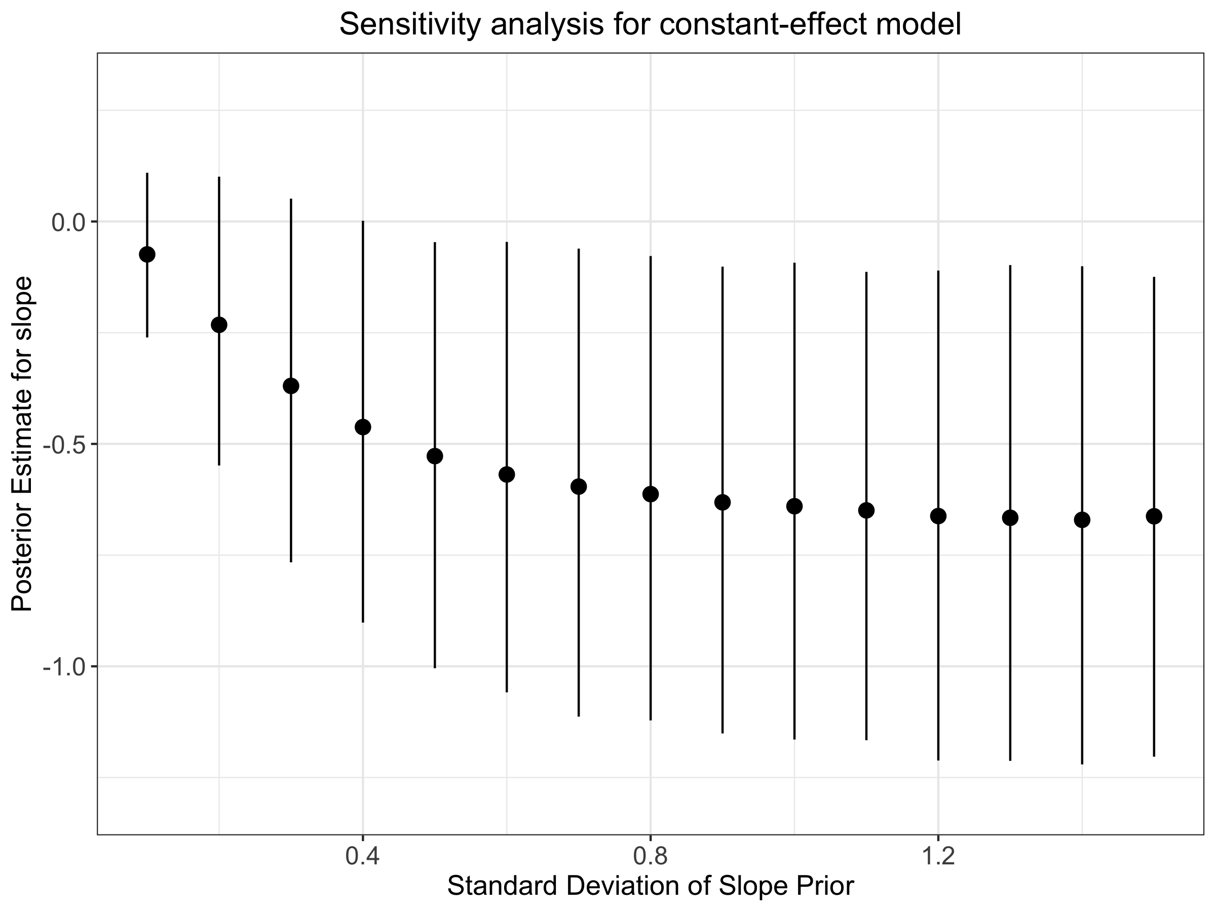
Robustness checks?
But but but priors!!
The prior for beta might be affecting our results
Let’s keep MU=0
Let’s vary SD: from 0.1 to 1.5 this changes how confident we are

Slide 66
Bonus slide: it’s turtles all the way
We sometimes worry about heteroskedacity: what if the variance is not the same between the two groups?

Slide 67
Bonus slide: it’s turtles all the way
Do not worry, model it!
Articulation ~ Normal(mu, sigma)
Mu = Intercept + b * Register
Sigma = InterceptS + bS * Register
Articulation_f2S <- bf( Articulation ~ 1 + Register Sigma ~ 1 + Register)

Slide 68
Bonus slide: do priors scale?
Can we keep the same prior if we have more predictors?
E.g. articulation as a function of the big 5
Articulation ~ 1 + Register * (Extraversion + Neuroticism + …)
10 betas and 1 intercept
Alternatives:
Prior on R2 ( check ?R2D2)

Slide 69
Discussion
The intercept only model is an integral part of modeling the hypothesis, not just pedagogic.
Intercept-only is something that you should do everytime you model anything to make sure you understand what you are doing
Model checks are largely independent from hypothesis testing
But robustness checks!
Robustness checks indicate our prior for beta is not in the stable area. What to do?
What should we think about vowel hyperarticulation in Danish IDS?

Slide 70
Second Part

Slide 71
Recap and questions
Bayesian modeling is a way of formalizing (step-by-step) what you know of the data.
We start simple, and build progressively
We specify our knowledge and obsessively check the implications and the robustness of our estimates
Prior/posterior parameter distributions and predicted outcomes
Is this starting to make you more comfortable with the idea of priors?
Questions?

Slide 72
Multilevel modeling

Slide 73
What is multilevel modeling?
It’s introducing structure (multiple levels) in your parameters
E.g. the difference by register
There is an overall mean difference (population level estimate)
There is a difference within each participant (individual level estimate)
A within subject contrast / repeated measures: each mother speaks w both their child and a researcher

Slide 74
What is multilevel modeling?
Accounting for repeated measures

Slide 75
What is multilevel modeling?
Accounting for repeated measures
Modelling individual level effects

Slide 76
What is multilevel modeling?
Accounting for repeated measures
Modelling individual level effects
Partial pooling

Slide 77
Partial pooling?
We are not taking the data at face value:
We think there might be noise, or idiosinchrasies in the data

Slide 78
Partial pooling?
We are not taking the data at face value:
We think there might be noise, or idiosinchrasies in the data
We “adjust” each participant level data with what we learn from the other participants, pulling them towards the mean
The more outlying the cluster (participant), the more the shrinkage
The fewer datapoints in the cluster, the more the shrinkage

Slide 79
Partial pooling?
We are not taking the data at face value:
We think there might be noise, or idiosinchrasies in the data
We “adjust” each participant level data with what we learn from the other participants, pulling them towards the mean
The more outlying the cluster (participant), the more the shrinkage
The fewer datapoints in the cluster, the more the shrinkage
Multilevel models are for generalizability
A multilevel model should give you better inference for the specific cluster (by partial pooling, learning from other data)
A multilevel model should give you better inference for the population level estimates

Slide 80
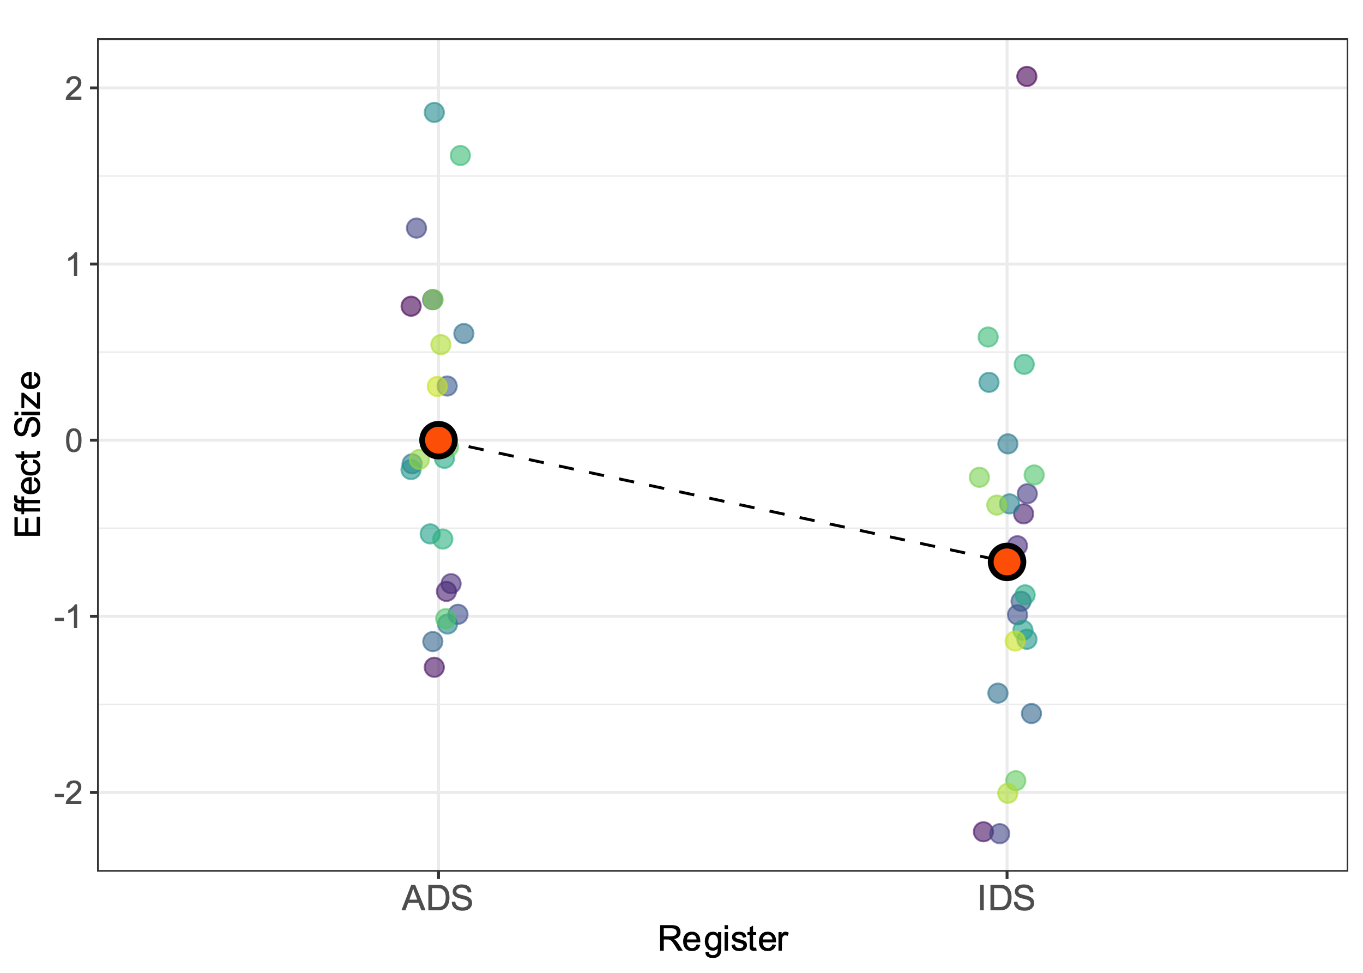
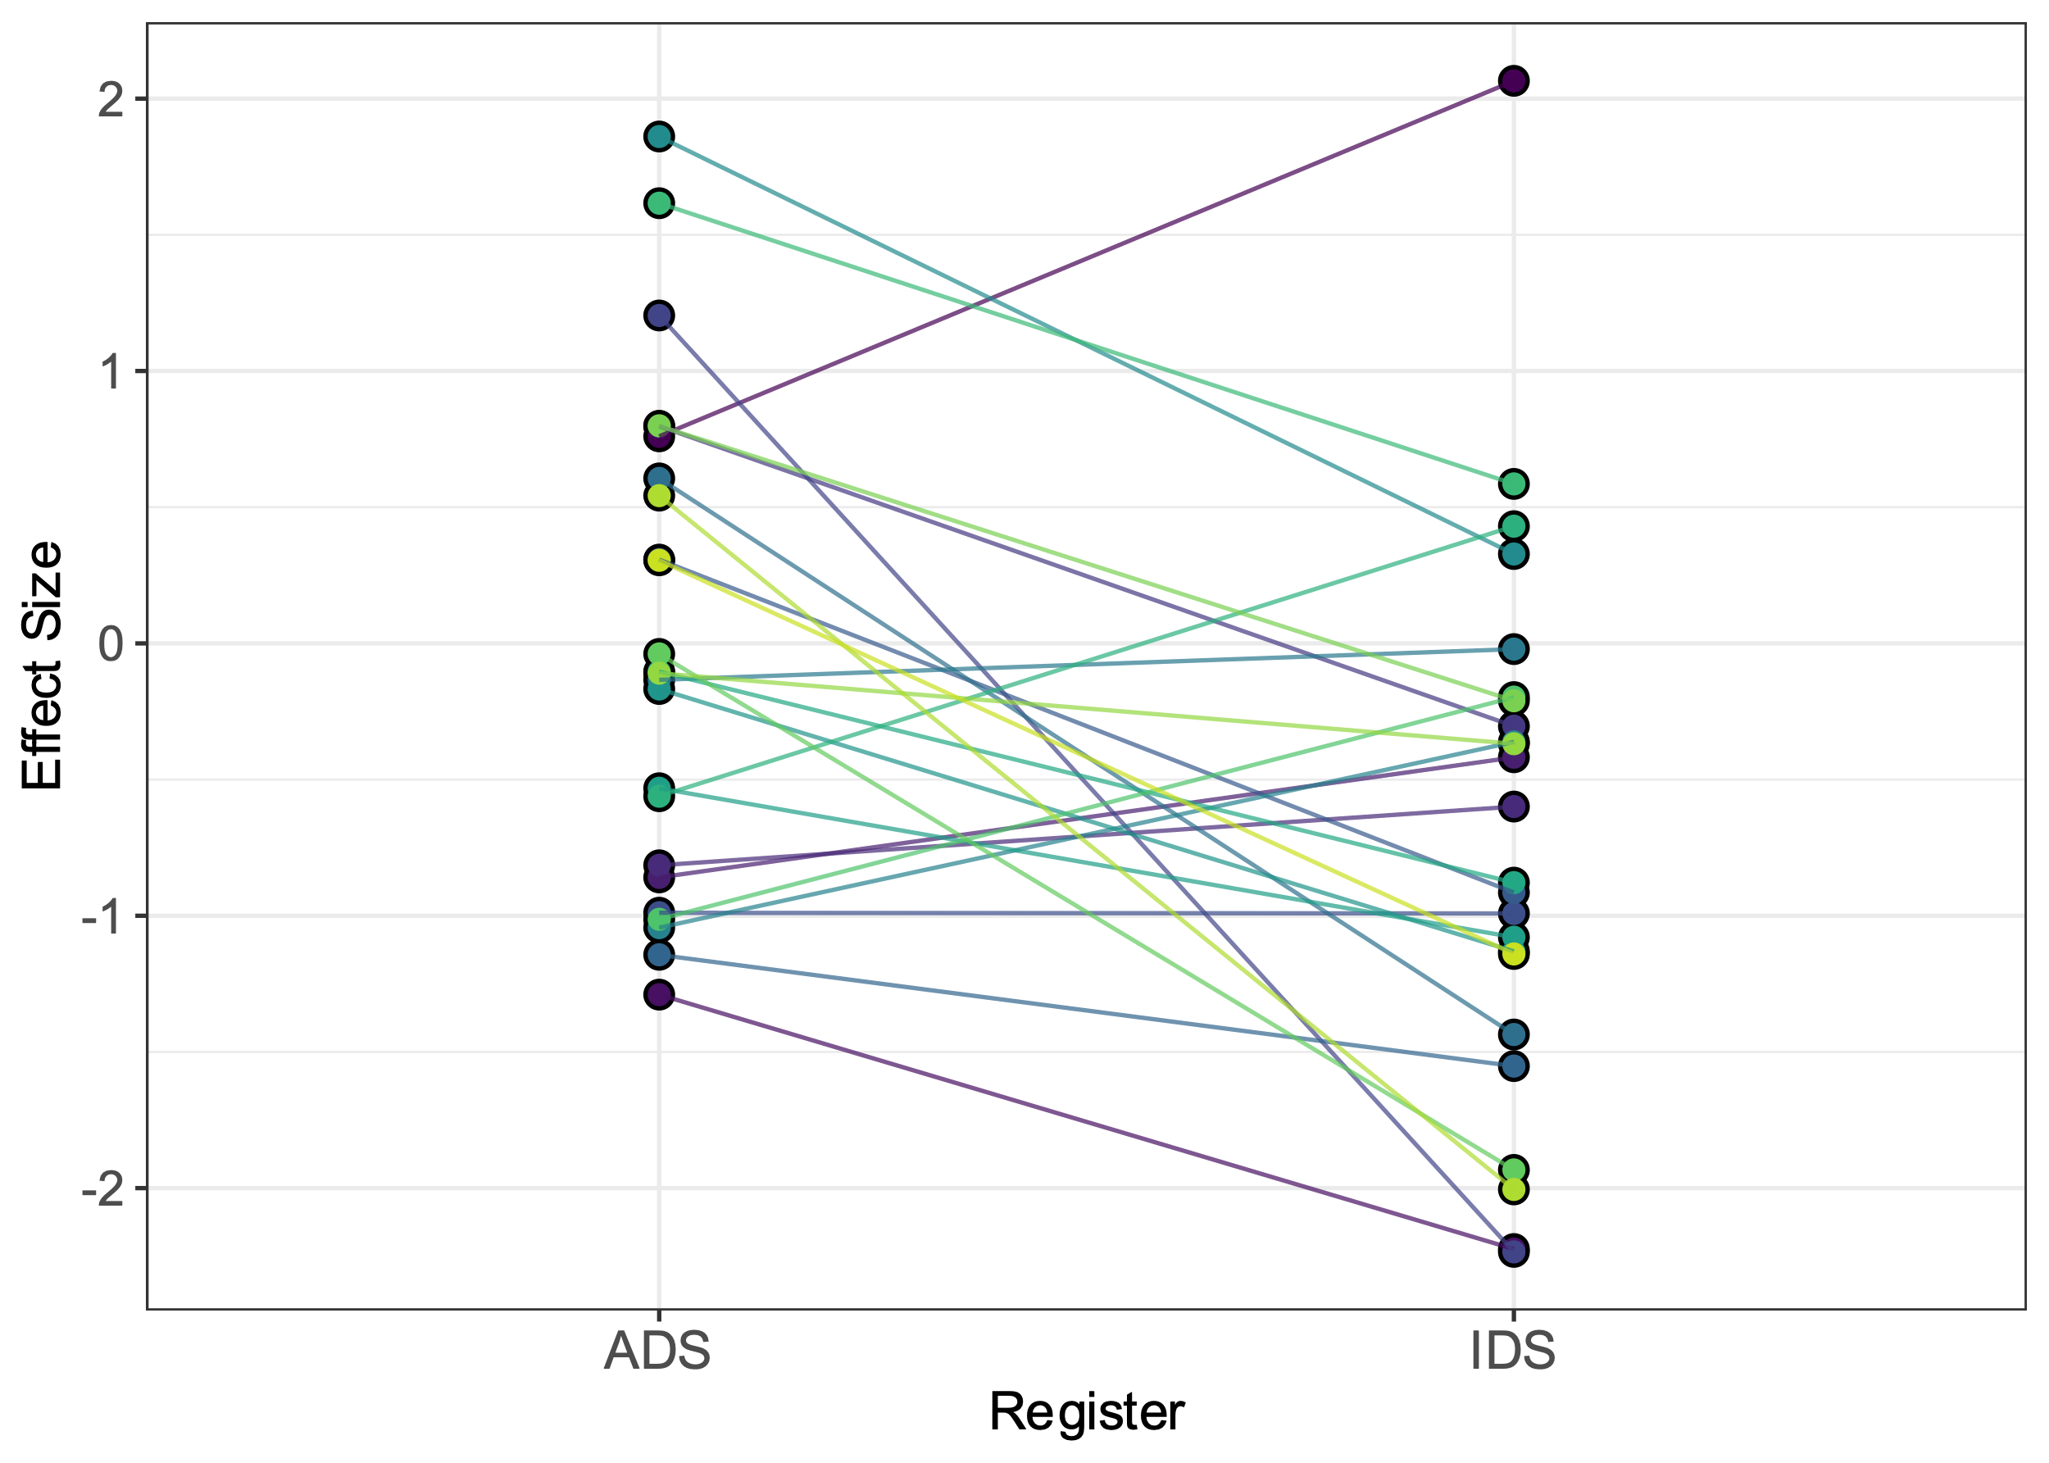
our data

Slide 81
Data

Slide 82
Individual level estimates
Data

Slide 83
Pop level estimates
Individual level estimates
Data

Slide 84
Priors
Pop level estimates
Individual level
estimates

Slide 85
Ok, How do we code this?
Articulation_f3 <- bf( Articulation ~ 1 + Register + (1 + Register| ID)
Articulation_{ID} ~ Normal(mu_{ID}, sigma)
Mu_{ID} = Intercept_{ID} + b_{ID} * Register
Intercept_{ID} ~ Normal(Intercept_{POP}, SigmaInt_{POP})
B_{ID} ~ Normal(B_{POP}, SigmaB_{POP})
The parameters Intercept and bRegister *vary* by participant (ID)
The parameters Intercept and bRegister have levels:
Population (what is the mean of the population?): Intercept_{POP}, b_{POP}
[Group (we expect individuals to deviate, what is the expected deviation?) SigmaINT_{POP}, SigmaB_{POP}
Individual (we expect each individual to have its mean) Intercept_{ID}, B_{ID}
Intercept_{POP}
SigmaINT_{POP}
B_{POP}
SigmaB_{POP}
Sigma

Slide 86
Priors
Get_prior(Articulation_f3, data = data, family = gaussian)
Intercept_{POP} SAME: prior(normal(0,1), class=Intercept)
SigmaINT_{POP.}
B_{POP.} SAME: prior(normal(0, 0.3), class=b)
SigmaB_{POP}
Sigma SAME: prior(normal(1, 0.5), class=sigma)

Slide 87
Priors
Get_prior(Articulation_f3, data = data, family = gaussian)
Intercept_{POP} SAME: prior(normal(0,1), class=Intercept)
SigmaINT_{POP.} VAR in INT prior(normal(0,1), class = sd, coef = Intercept)
B_{POP.} SAME: prior(normal(0, 0.3), class=b)
SigmaB_{POP} VAR in SLOPE prior(normal(0,1), class = sd, coef = RegisterIDS)
Sigma SAME: prior(normal(1, 0.5), class=sigma)

Slide 88
Priors
Pop level estimates
Individual level
estimates

Slide 89
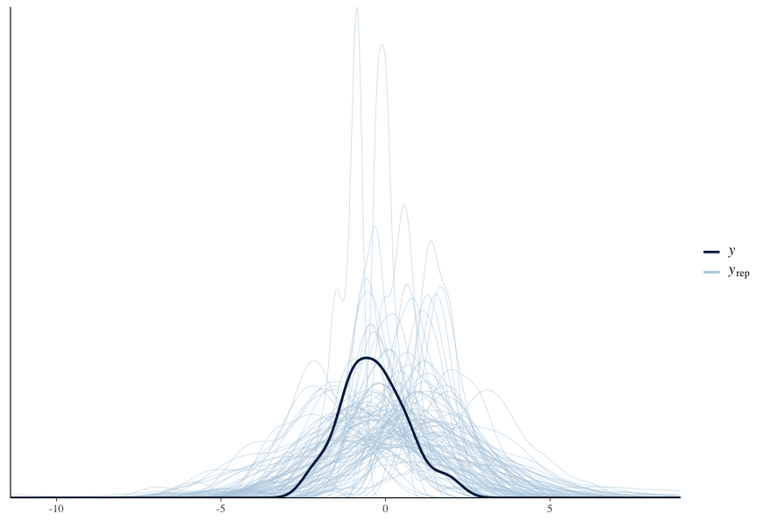
predictive checks
Before seeing the data
After seeing the data

Slide 90
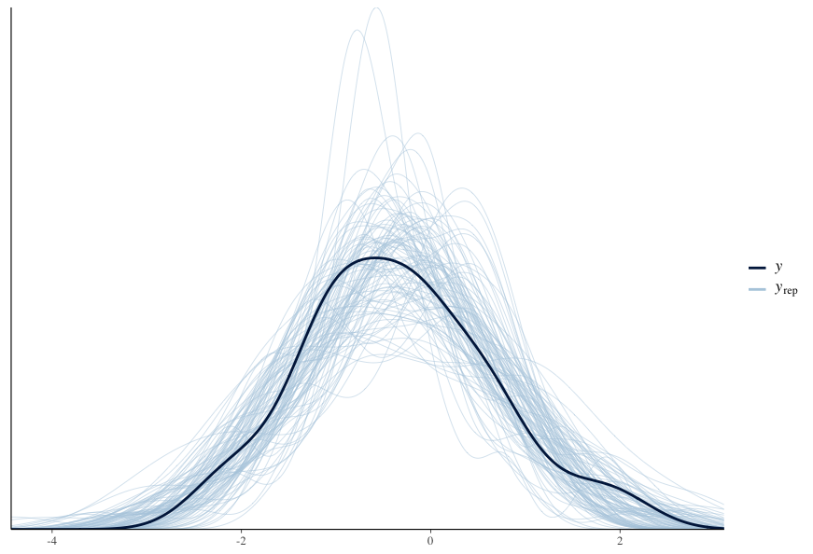
predictive checks
Before seeing the data
After seeing the data

Slide 91
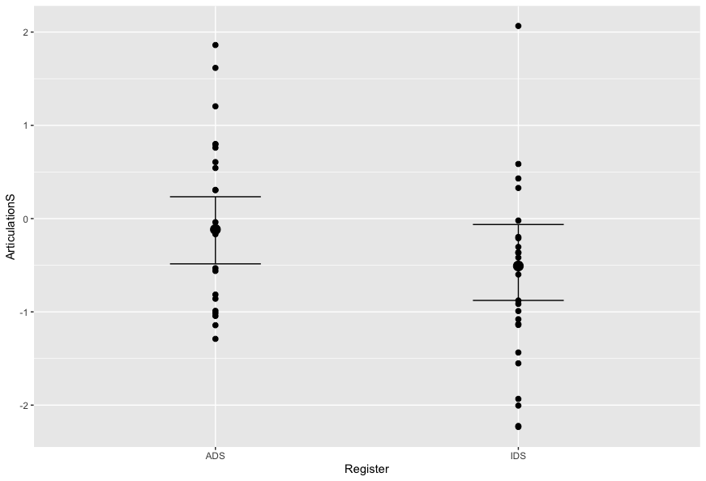
Posterior Predictive checks
Conditional_effects(Articulation_m3)
Plot(Conditional_effects(Articulation_m3), points=T)

Slide 92
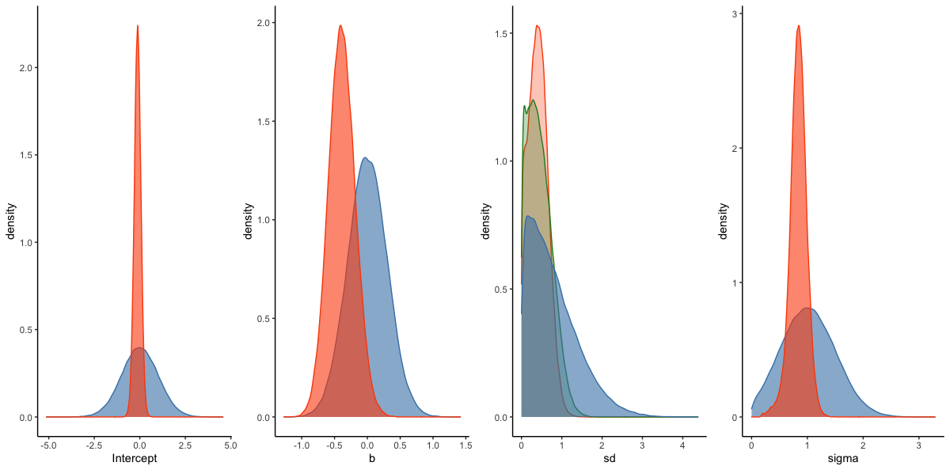
Prior posterior updates
prior(normal(0,1), class=Intercept)
prior(normal(0,1), class = sd, coef = Intercept)
prior(normal(0, 0.3), class=b)
prior(normal(0,1), class = sd, coef = RegisterIDS)
prior(normal(1, 0.5), class=sigma)

Slide 93
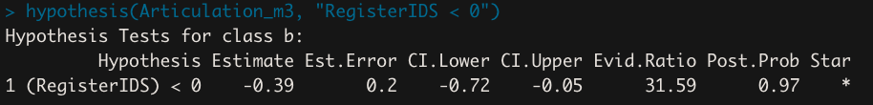
Assessing the contrast
Former model (part 2)
Multilevel

Slide 94
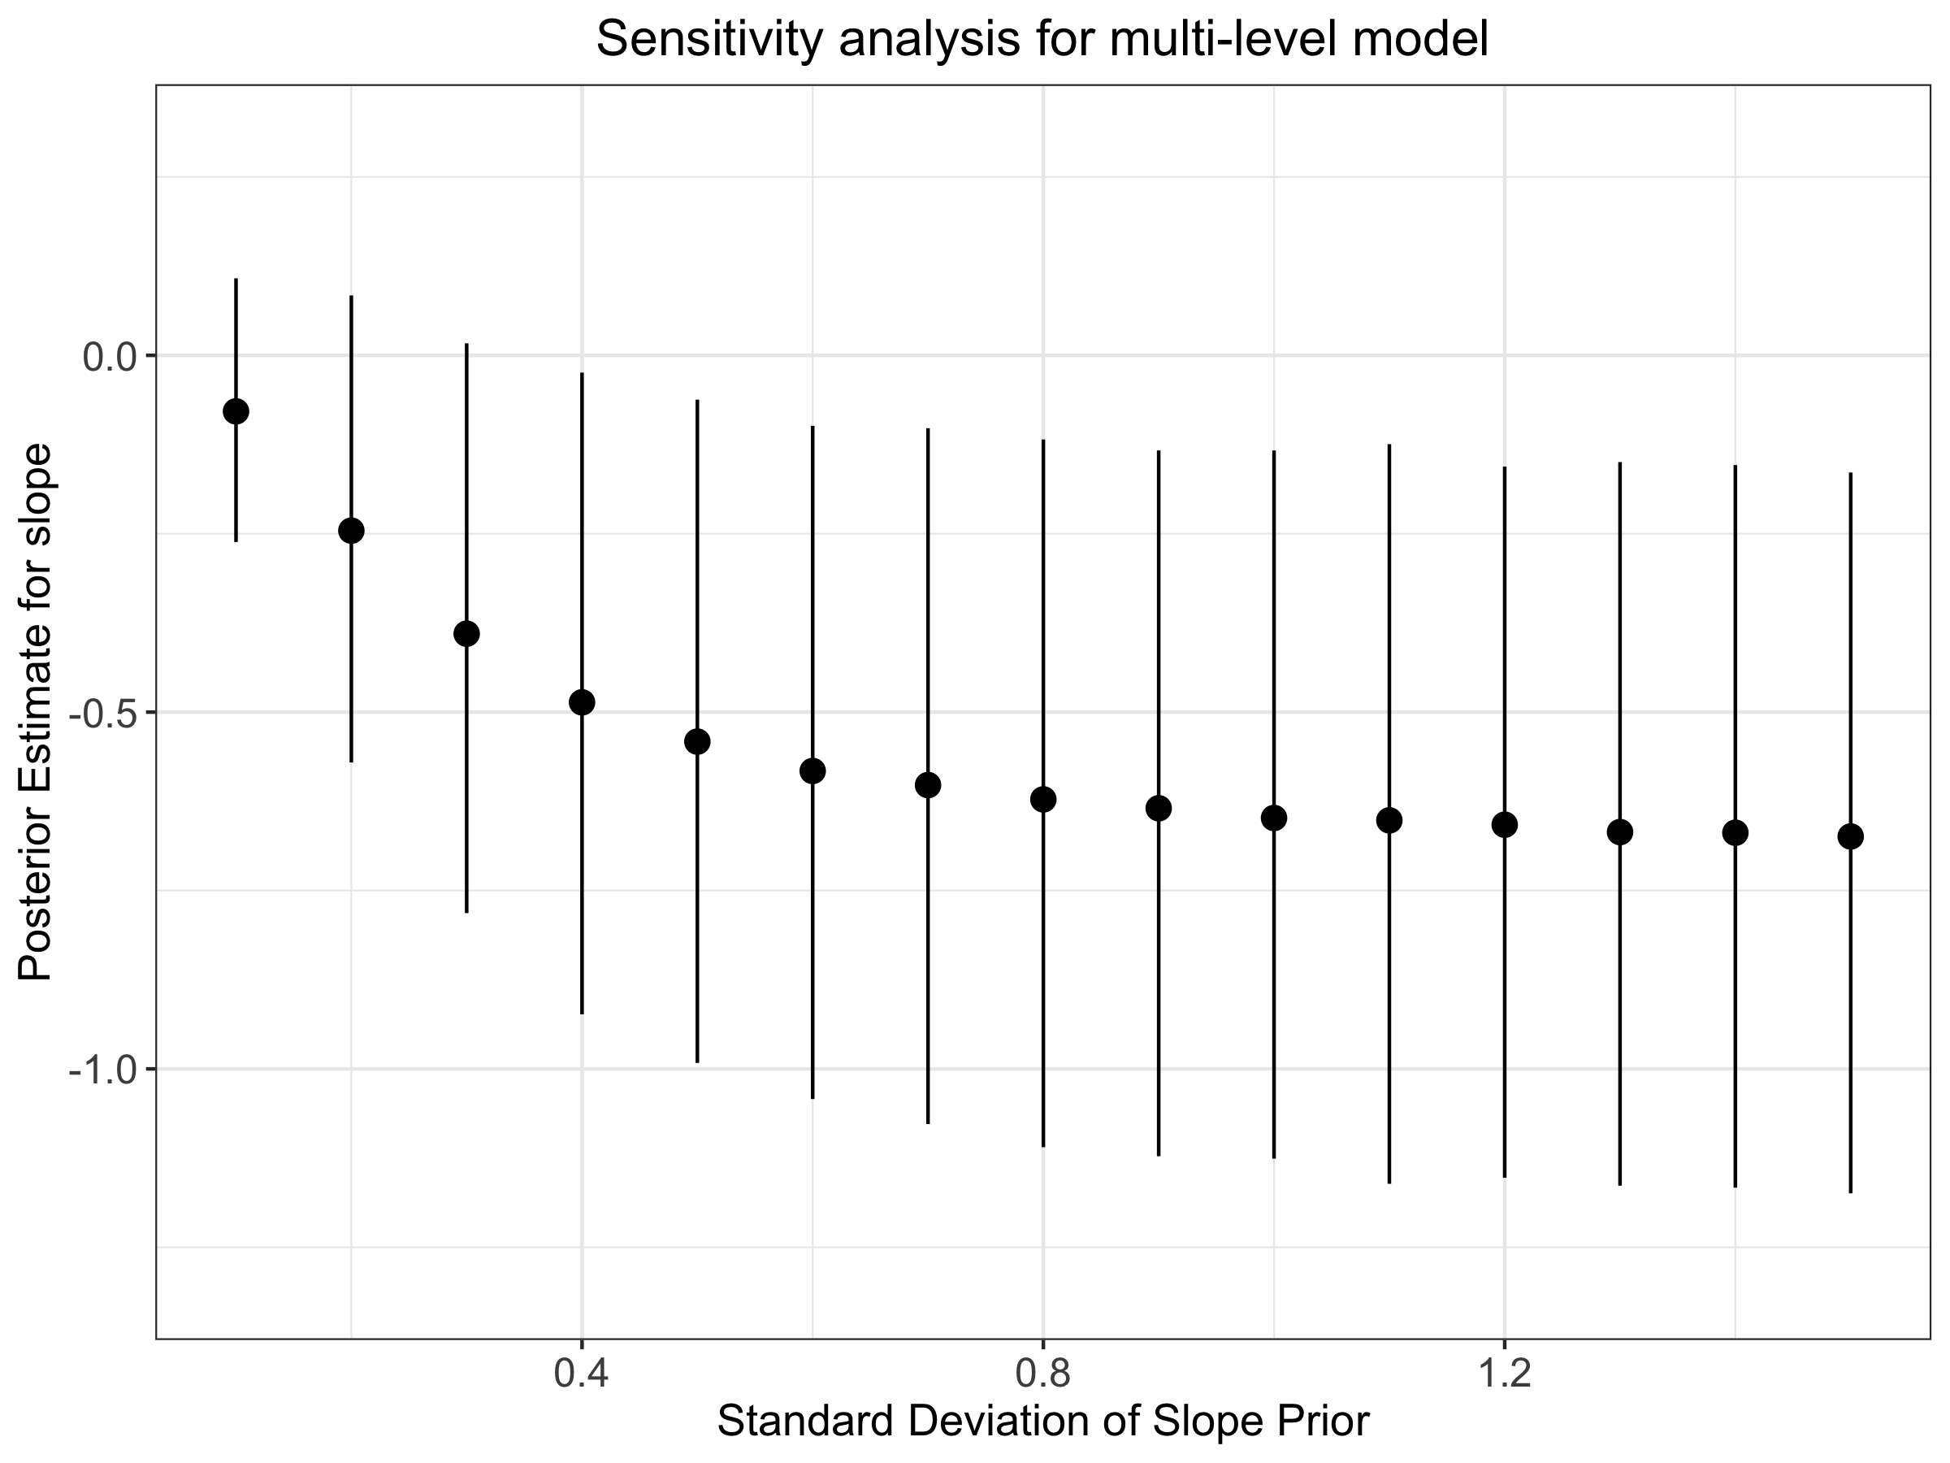
Robustness checks

Slide 95
From model 2 to model 3

Slide 96
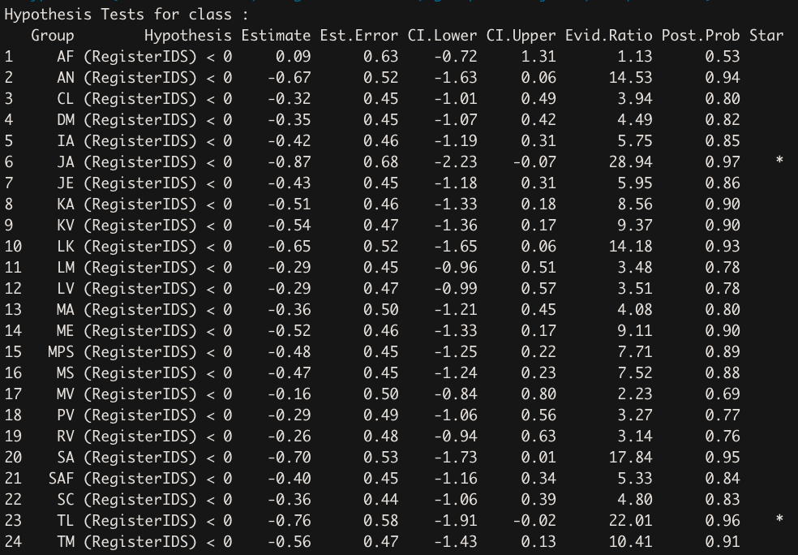
Hypothesis Testing - Individuals
Hypothesis(Articulation_m3, “Register < 0”, group = “ID”)
Wait a sec, weren’t there positive effects for some participants?

Slide 97
The data

Slide 98
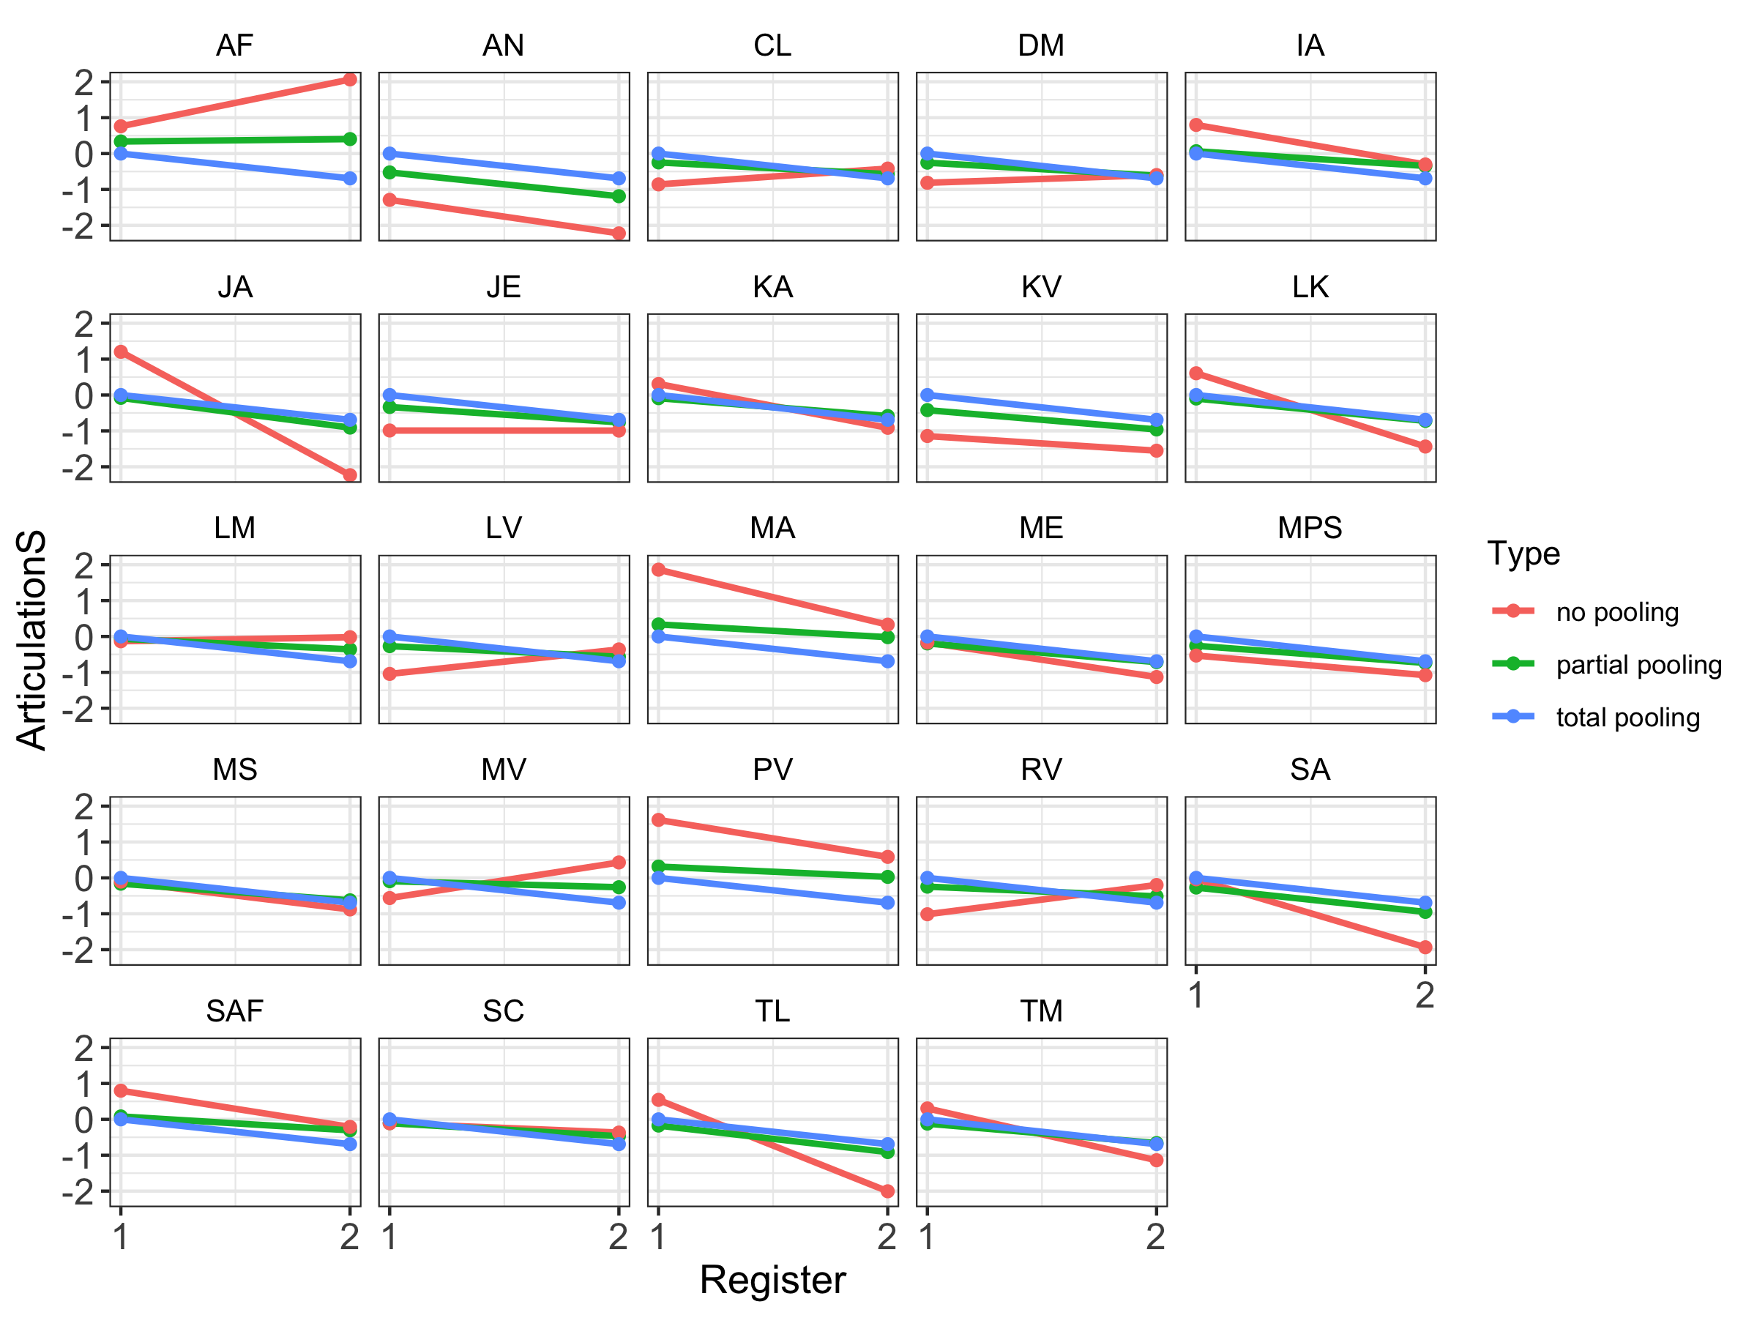
Partial Pooling

Slide 99
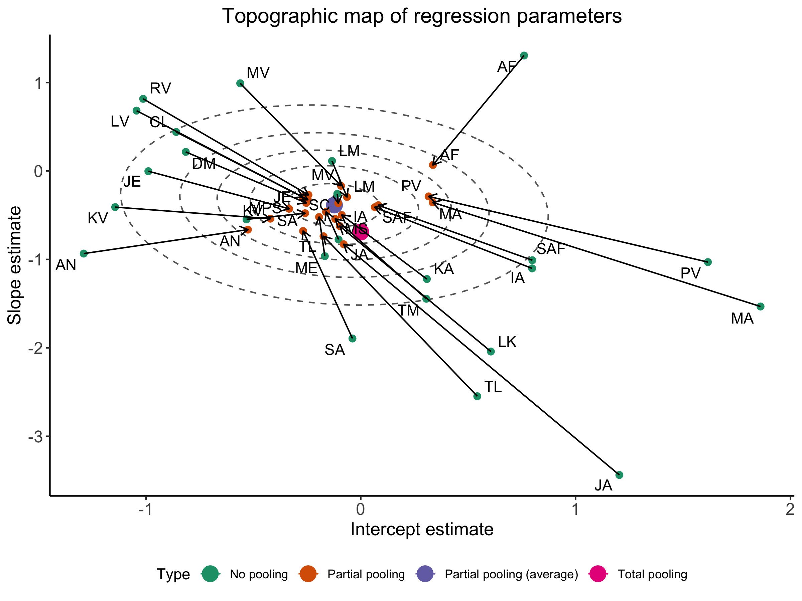

Slide 100
But also
“There were 12 divergent transitions after warmup”
“Catastrophic” fail.
What to do now depends on
Our theoretical assumptions and ongoing theory building (e.g. do individual variations of this size make sense? What could be the source of such variation? How would we investigate it? Etc.)
How much we trust our data (how robust is the measurement? Is one data point per condition persuasive? Etc.)

Slide 101
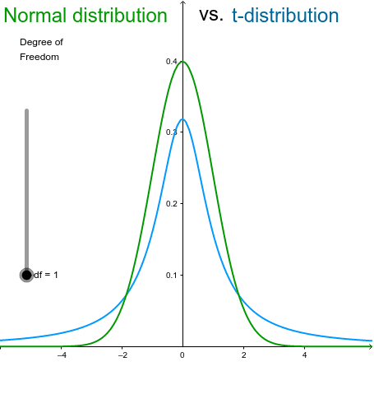
changing likelihood
How can we better accommodate those diverse participants?
But also go back
to data
(field notes,
Listening,
Pre-processing)
Family = gaussian -> family = student -0.64 [-1.14; -0.13]

Slide 103
What to do next?
Collect more data!
Modeling what we think might cause the difference
Parental attitude?
Assume there is a mixture of populations (e.g. 2: hyper-articulators and hypo-articulators, or contrarians and rule-followers) and model the outcome as a mixture of two gaussians
Each participant is estimated as having a certain probability to belong to each gaussian
Each mu and sd for each gaussian is also estimated

Slide 104
Part 3

Slide 105
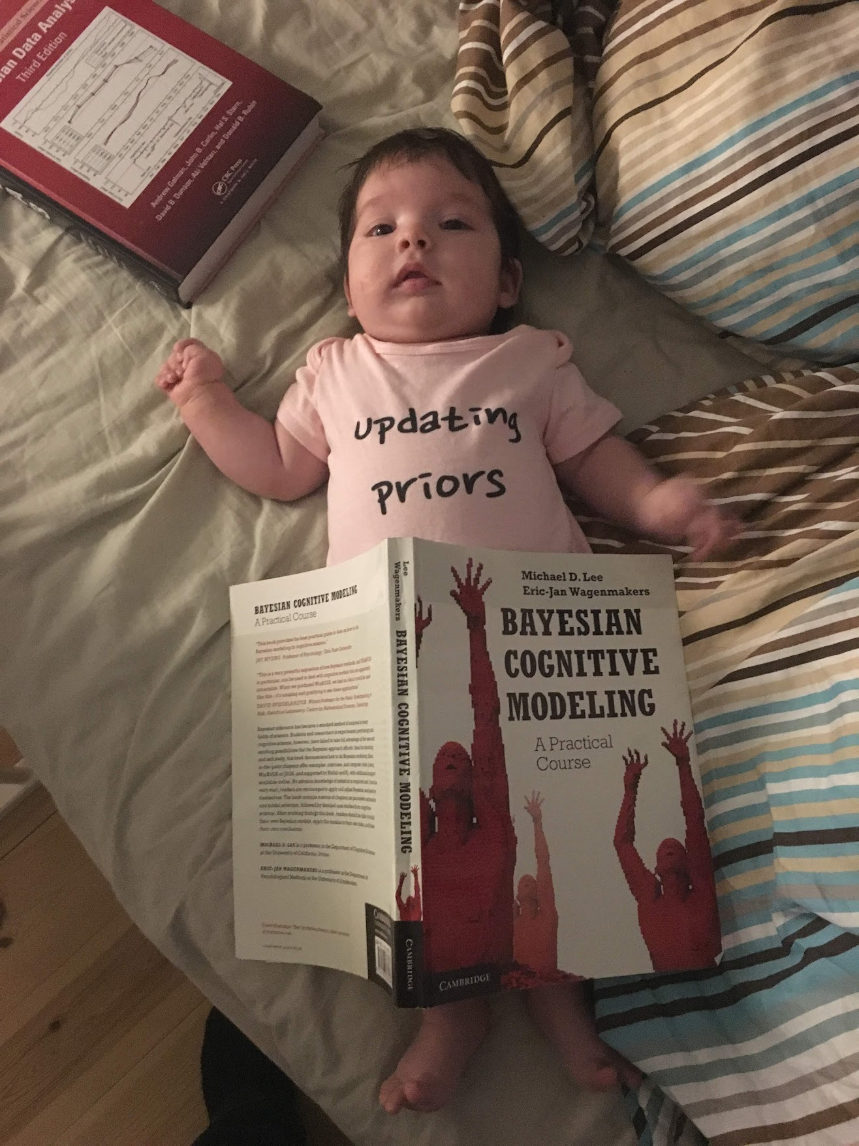
Using informed priors

Slide 106
Two additional priors
Meta-analysis
Danish study (Christina)
Mean ES: 0.62, SE = .13
(Lovcecic et al, in prep)
Mean ES: -0.1, SE = 0.04
(Dideriksen et al, unpublished)

Slide 107
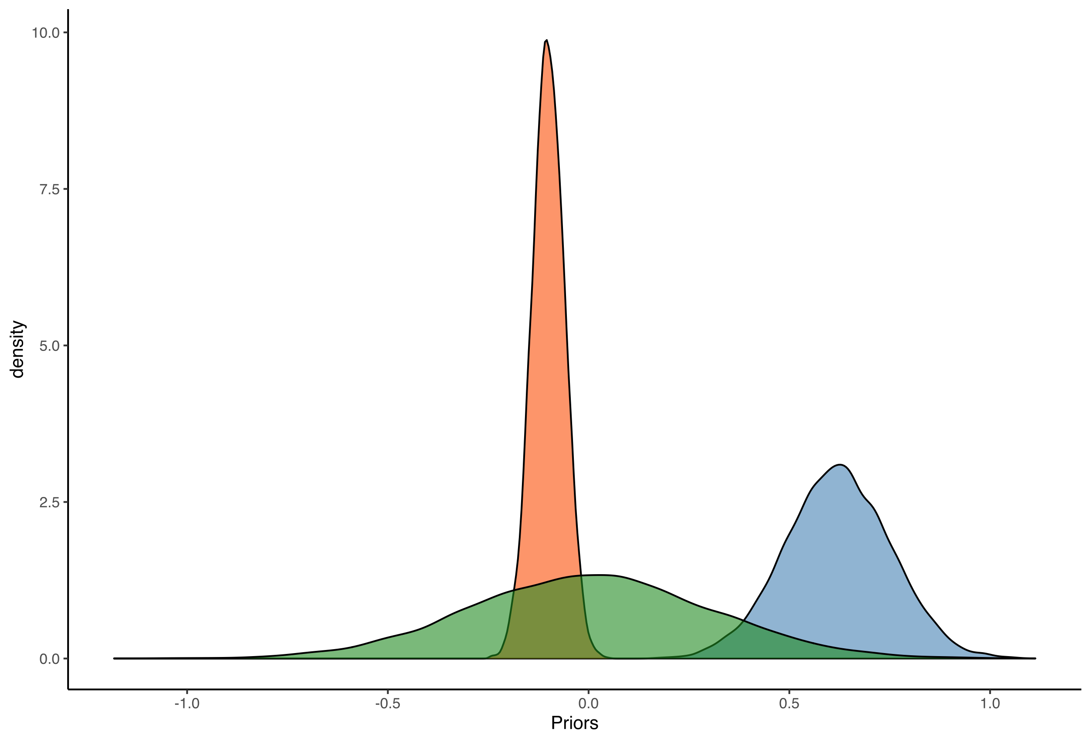
Two additional priors
Meta-analysis
Danish study (Christina)
Mean ES: 0.62, SE = .13
Mean ES: -0.1, SE = 0.04
df <- tibble(MA=rnorm(1e4,0.62, 0.13), Christina=rnorm(1e4,-0.1, 0.04), skeptical= rnorm(1e4, 0, 0.3))
ggplot(df) + theme_classic() + geom_density(aes(MA), alpha=0.3, fill="steelblue")+ geom_density(aes(Christina), alpha=0.3, fill="orange") + geom_density(aes(skeptical), alpha=0.3, fill="darkgreen")

Slide 108
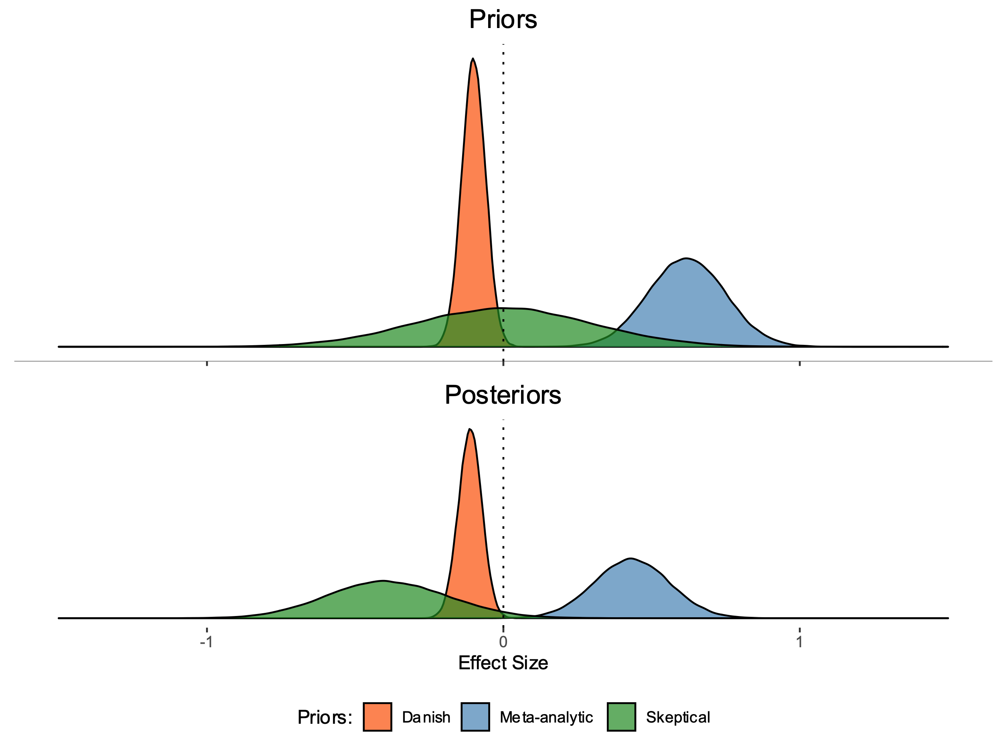
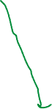
How do The informed Priors update After seeing the data?
Comments?

Slide 109

How do The informed Priors update After seeing the data?
Why do the Danish and MA posteriors not shift as much as the skeptical one?
Is this good or bad?
IF you think this is bad, what would you do to ameliorate the situation?
What does this tell us about the nature of evidence accumulation in Bayesian models?
The data is pushing towards hypoarticulation
But where you start from matters.
Also how confident you were matters.
Comparative modeling is a good way to
better assess the results and how strongly they change the current picture

Slide 110
Remember: Critical stance!
Prior predictive checks
Posterior predictive checks
Prior-posterior update checks
Comparing priors
Plots plots plots
It’s ok to adjust (the sd)
Is it posterior-hacking?
We don’t care about the effect at this stage, just to properly model our data!

Slide 111
A critical cumulative Science
How do we cumulate evidence?
Brand, C. O., Ounsley, J. P., van der Post, D. J., & Morgan, T. J. H. (2019). Cumulative Science via Bayesian Posterior Passing: An introduction. Meta-Psychology, 3.
Follow-up in the work with realistic networks of citations
But we want to avoid blindspots / blind alley
Devezer, B., Nardin, L. G., Baumgaertner, B., & Buzbas, E. O. (2019). Scientific discovery in a model-centric framework: Reproducibility, innovation, and epistemic diversity. PloS one, 14(5), e0216125.
Follow-up in the works with introducing community structures and posterior passing
An example trying to do both
Fusaroli et al (2022) Toward a cumulative science of vocal markers of autism. Autism Research.

Slide 112
Summing up
The Bayesian framework allows you to build up your own model according to your study design and data
The apparent increase in complexity and subjectivity is simply an effect of you becoming aware of the modeling choices and their implications
E.g. Priors, likelihood functions and other modeling choices are disclosed researcher’s degrees of freedom
You need to go slow and visualize all the way through

Slide 113
The Bayesian WorkFlow
Start simple and keep iterating and improving!
Define your most basic model (e.g. Articulation ~ 1)
Identify likelihood (here: Gaussian, or Student?)
Identify priors
Define priors
Assess priors (plots, prior predictive checks)
Fit the model
Check for issues
Posterior predictive checks
Prior posterior update checks
Increase model complexity
…
Hypothesis testing / model comparison
Keep it rigorous!
Visualize and understand your choices
Test the robustness of your results

Slide 114
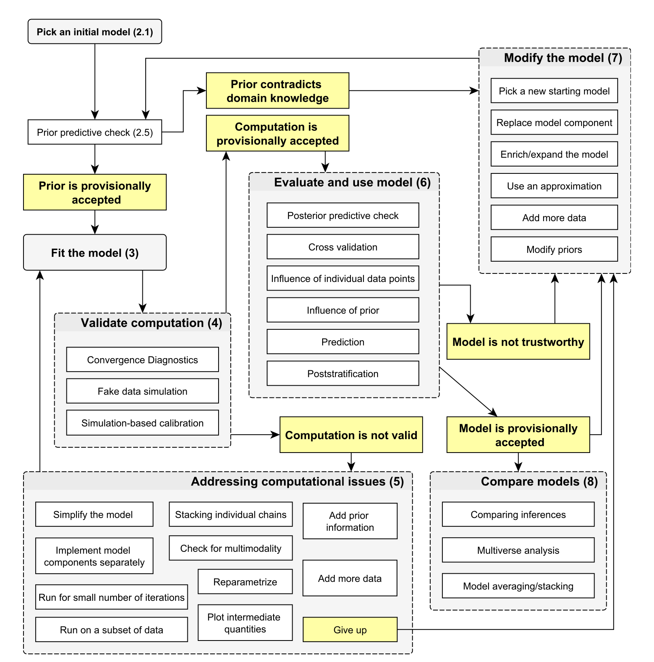
A more comprehensive Bayesian WorkFlow
Gelman et al (2020). Bayesian workflow. arXiv preprint arXiv:2011.01808.
Includes model and parameter recovery tests (e.g. Simonsen et
al 2021, Taking Others into Account,
Brain)

Slide 115
From Causal Inference to Model Comparison
Causal Inference:
principled formalization and tentative test of causal assumptions
identifying the mechanisms, that is,
”Experimental” / counterfactual angles (if we changed x, what’d happen to y?)
Model Comparison: predictive inference
Predictions do not care about the direction of the flow, and only limitedly about direct vs. Indirect connections.
Observational angle (if we see x is n, what should we expect y to be, independently of the cause?)
N.B. the two can clash and give different results!
E.g. my son disappearing to the other room and no sounds coming
E.g. post treatment bias
See Richard’s video lecture for an example that got cut from the book: https://youtu.be/gjrsYDJbRh0

Slide 116

Why do we need model comparison?
Overfitting
Underfitting
Overfitting: Learning too much from the data. Complex models always fit better, but often predict worse.
Underfitting: Learning too little from the data. Too simple models both fit and predict poorly.

Slide 117
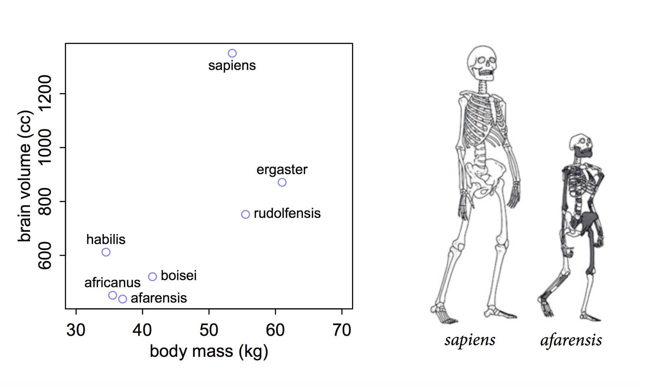

Slide 118
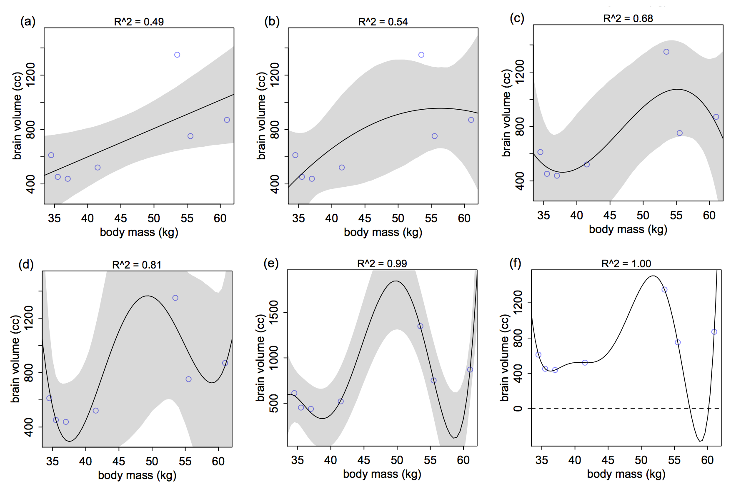

Slide 119
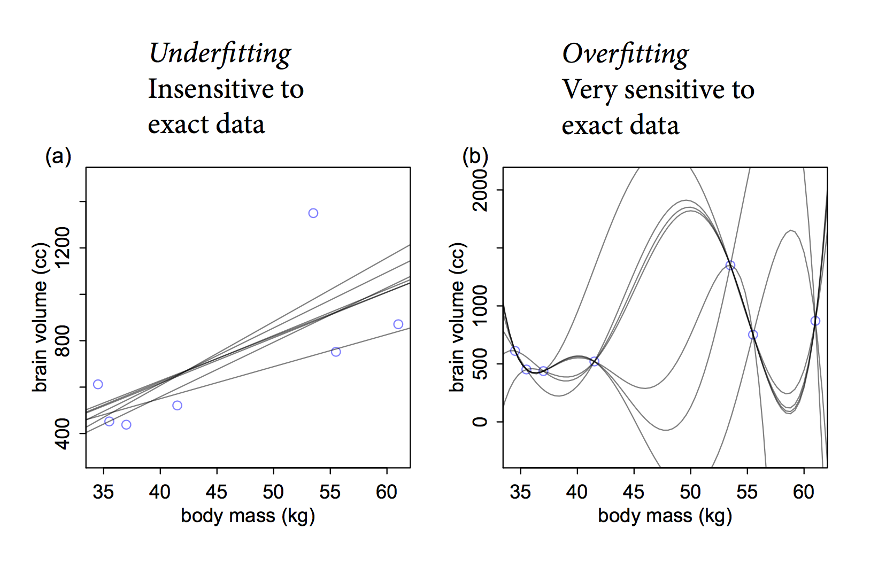

Slide 120
Why then model comparison?
Assessing overfitting
Feature comparison
Model comparison
N.B. Predictive, not causal inference approach
does adding X3 reduce error on out-of-sample data?
N.B. Regularizing priors always help in a complementary fashion by reducing overfitting (while model comparison measures it)

Slide 121
How?
Validation and Cross-Validation
Actual out-of-sample error (ability to generalize to new data)
Slow! Think of my 6 weeks models…
Actual error
Information Criteria:
*Estimated* out of sample error
Fast
Ridden with assumptions, depending on the specific IC:
e.g. Gaussian estimates
E.g no influential data point
E.g. flat priors
E.g N much bigger than k

Slide 122
Information criteria
AIC = loglikelihood(model|data) + 2p (the lower the better)
2 p is a penalization
BIC = loglikelihood(model|data) + log(n)p
AICc = loglikelihood(model|data) + 2p + (2p² + 2p)/(n-p-1)

Slide 123
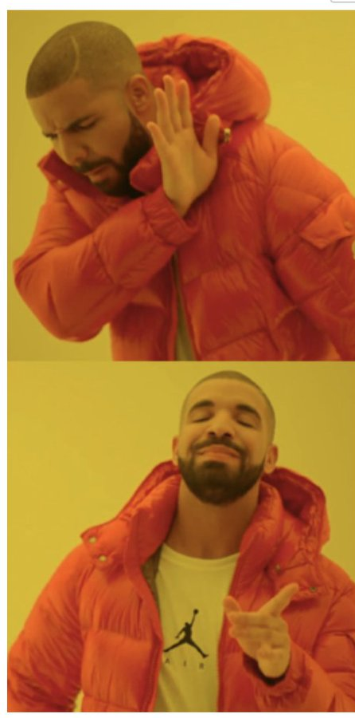
Information criteria
Global likelihood of the model penalized by model complexity (and possibly corrected by sample size)
BUT: only 1 value, no uncertainty
E.g multiple posterior samples, and multiple datapoints
Datapoint-level likelihood estimates with uncertainty?

Slide 124
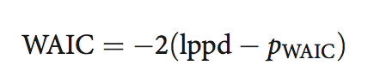
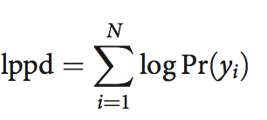
WAIC 1: point wise likelihood of the model
Per each datapoint we have a “cloud” of predictions (one per posterior sample)
Log pointwise predictive density (lppd) is the sum of the logarithm of the average likelihood of each observation ( Pr(yi) )
Pr(yi): per each observation
Likelihood for each parameter value
Average

Slide 125
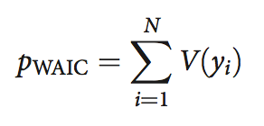
WAIC 2 Penalization due to complexity of the model
pWAIC is given by the sum of variance per each observation (V(yi))
V(yi) is the variance in log likelihood for observation I in the training sample
Per each observation calculate loglikelihood given each sample of the posterior, then calculate the variance (sum of squares divided n)
Sum all the variances
pWAIC corrects for observations that are hard to predict, penalizing non-robust models for which small changes in parameter values make big changes in loglikelihood
Better than parameter n (p), because parameters might be correlated or even help

Slide 126
Total WAIC!
Likelihood of the parameter values given the data
Variance in the likelihood as the parameter values change
N.B. 1 score per datapoint and one total score

Slide 127
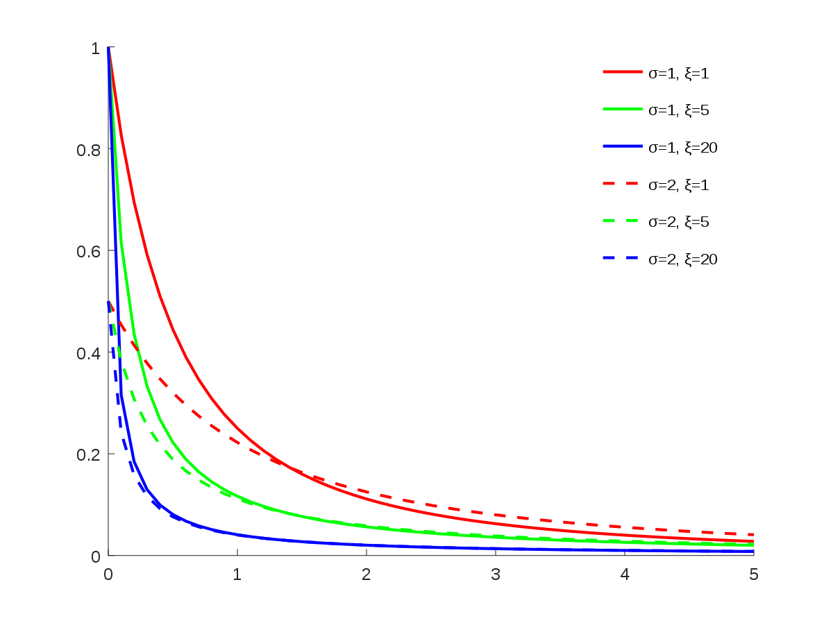
PSIS-LOO 1
PSIS-LOO is a fancier method developed by Aki Vehtari
Pareto Smoothed Importance Sampling
Importance Sampling:
Weights: Some informations are harder to predict / change the posterior more than others (higher weights)
Pareto smoothed:
Weights should follow a pareto distribution, which we use to adjust the weights (so no point gets too much influence)
However, if the variance of the distribution is too big (k > .7) we note the problematic observations that lead to that.

Slide 128
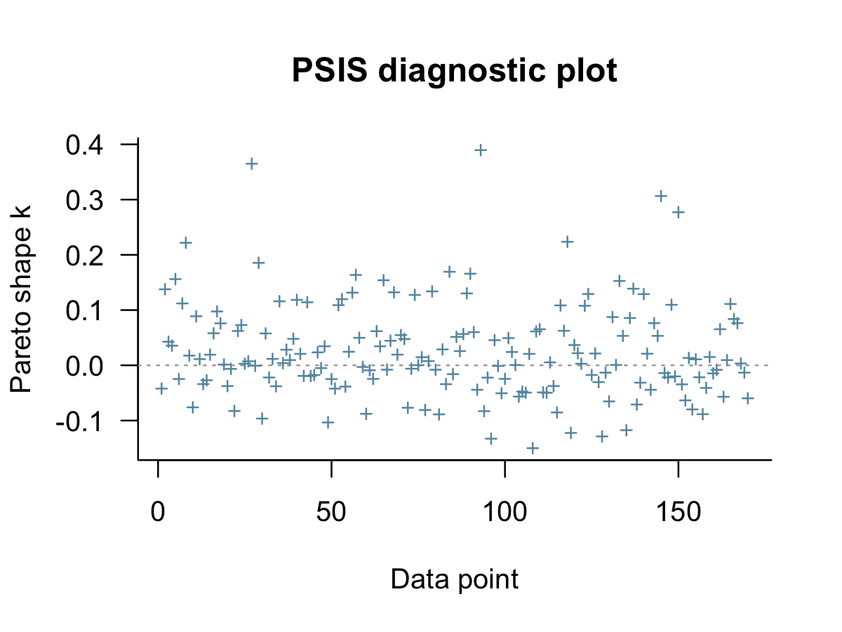
PSIS-LOO 2
Slower but more robust to weird posterior distributions and influential data points
Telling you about influential datapoints!
Data checking (sometimes with theoretical implications, sometimes likelihood, prior and data quality)
Robust regression
Reloos

Slide 129
So what?
IC with uncertainty: is any model substantially better than others?
Global likelihood that is mindful of single datapoints
Penalization that is mindful of tricky datapoints and not naïve about parameters
Potential diagnostic tool:
Which data points are tricky for the model?
Are the data points differentially tricky?
E.g. these are easier for the model including variable x1 and trickier when you exclude it
Actually comparing our models beyond which is better:
Stacking weights

Slide 130
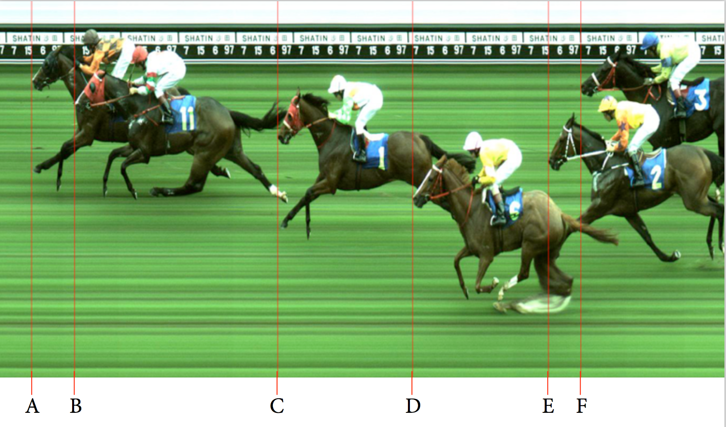
Model comparison vs. model selection

Slide 131
Stacking weights
Given our models are all possible models: their probability of being the true model sums to 1
What is the probability of each model to be true (under the assumption of the true model being included)?
N.B. Very similar models (aka models presenting similar probability distributions of outcomes for the same datapoints) give all the weight to the simplest model
How similar the predictions are between models? What do we learn from the predictions of this model if we already know the others?

Slide 132
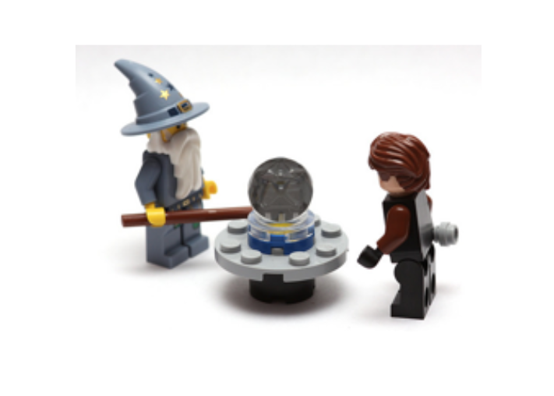
Where is the catch?
Relative measure: if all models are crap, the best model is still crap
Pointwise measure: what if data points are not independent from each other?

Slide 133
Re-cap
Underfitting possible; overfitting inevitable
Regularizing priors reduce overfitting
Information criteria measure overfitting in a comparative fashion (which model overfits least)
So also use regularizing priors!
PSIS-LOO gives you further insight into
Problematic data points
Complementarity of models

Slide 134
Now we have all the tools to do model comparison

Slide 135
Model selection, comparison and averaging
Model selection: pick the model with the lowest PSIS-LOO
Model comparison: use IC’s to compare models and assess their parameter estimates to understand why one model outperforms the others
Science is (mostly) not about “decisions”, it’s about cumulating and critically assessing evidence: why not provide a critical discussion of all the models that have a decent amount of evidence and let’s science do its thing in the longer run?
Some data points might be differentially predicted by models telling us something about differential factors at play
Model averaging: use stacking weights to combine the predictions of all models (ensemble machine learning)

